Slide 1


R. GLENN
HUBBARD
ANTHONY PATRICK
O’BRIEN
FIFTH EDITION
© 2015 Pearson Education, Inc.

Slide 2
Public Choice, Taxes, and the Distribution of Income

Slide 3
What role should government play?
So far, we have seen relatively limited evidence for government intervention in markets. Governments have been able to reduce deadweight loss (improve economic efficiency) by:
Ensuring public goods are provided
Regulating markets with few firms
Altering the quantity traded in the presence of externalities
But how can we tell what government should do, for example:
When choosing between competing public projects?
When deciding who to tax?
We will study these types of questions in this chapter.

Slide 4
Public Choice
18.1
Describe the public choice model and explain how it is used to analyze government decision making.

Slide 5
The public choice model
An important insight of recent research on governmental activities is that government policymakers are people too, rationally interested in themselves just like consumers and firm managers.
They seek to make themselves as well off as possible, which often involves increasing their re-election chances.
The public choice model is a model that applies economic analysis to government decision making, and can provide insight into the decisions that governments make.

Slide 6
Voting for a public project
Suppose that there is $1 billion available in the budget, and Congress must choose whether to spend it on only one of three alternatives:
Research on breast cancer
Subsidies for mass transit
Increased border security
For simplicity, assume there are only three voters, with preferences given in the table.
Policy | Lena | David | Kathleen
Cancer research | 1st | 2nd | 3rd
Mass transit | 2nd | 3rd | 1st
Border security | 3rd | 1st | 2nd
Table 18.1
The voting paradox

Slide 7
A > B > C > A?
If these policies came up for pairwise votes, and the voters voted according to their preferences, the outcomes would be as in the second table.
So there appears to be no way with majority voting to aggregate preferences into a sensible preference ordering for society.
Policy | Lena | David | Kathleen
Cancer research | 1st | 2nd | 3rd
Mass transit | 2nd | 3rd | 1st
Border security | 3rd | 1st | 2nd
Votes | Outcome
Cancer research versus mass transit | Cancer research wins
Mass transit versus border security | Mass transit wins
Border security versus cancer research | Border security wins
Table 18.1
The voting paradox

Slide 8
The voting paradox
This is known as the voting paradox: the failure of majority voting to always result in consistent choices.
But it turns out that not only can majority voting fail, so can any other system of voting.
This result is known as the Arrow Impossibility Theorem, a mathematical theorem that holds that no system of voting can be devised that will consistently represent the underlying preferences of voters.
Policy | Lena | David | Kathleen
Cancer research | 1st | 2nd | 3rd
Mass transit | 2nd | 3rd | 1st
Border security | 3rd | 1st | 2nd
Votes | Outcome
Cancer research versus mass transit | Cancer research wins
Mass transit versus border security | Mass transit wins
Border security versus cancer research | Border security wins
Table 18.1
The voting paradox

Slide 9
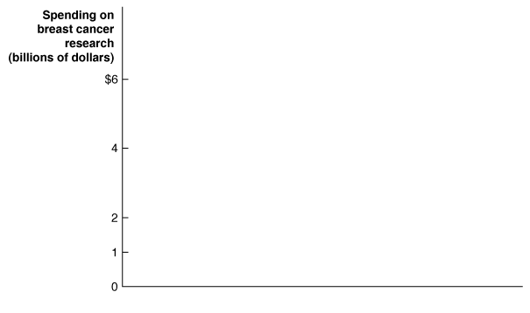

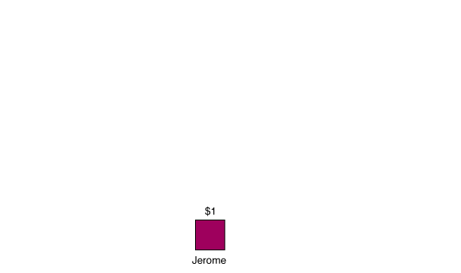
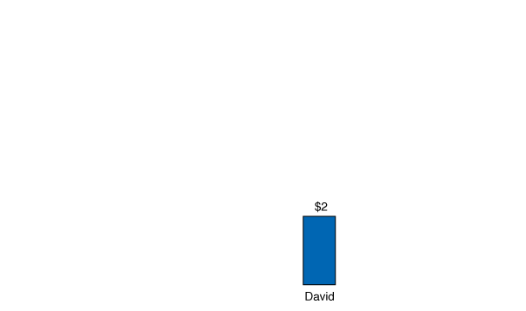
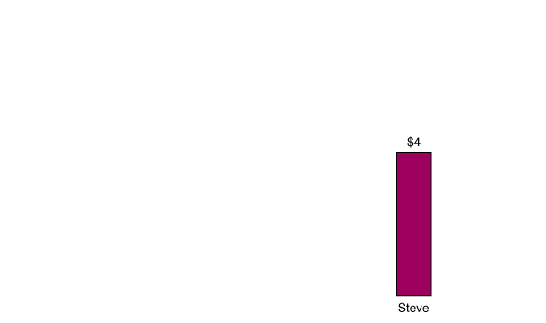
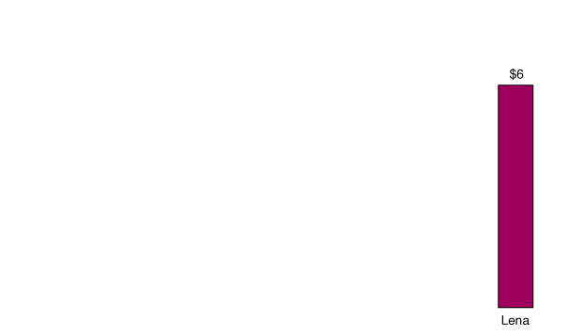
The median voter theorem
Since majority rule is so prevalent, it is important to understand its consequences.
One consequence,
known as the median
voter theorem, is the proposition that the outcome of a majority vote is likely to represent the preferences of the voter who
is in the “political middle”.
The figure shows the ideal policies of five voters.
$2 billion, the preferred policy of the median voter, would beat any other option in a pairwise vote.
Figure 18.1
The median voter theorem
Notes:
The median voter theorem states that the
outcome of a majority vote is likely to represent
the preferences of the voter who is in
the political middle. In this case, David is
in the political middle because two voters
want to spend more on breast cancer research
than he does and two voters want to
spend less. In any vote between a proposal
to spend $2 billion and a proposal to spend
a different amount, a proposal to spend $2
billion will win.

Slide 10
Government failure
We have seen previously that markets might fail to achieve the maximum possible surplus for society.
But governments might fail in this respect too.
We will consider three ways in which governments can fail:
Rent-seeking
Logrolling and rational ignorance
Regulatory capture

Slide 11
Rent-seeking
Rent-seeking refers to attempts by individuals and firms to use government action to make themselves better off at the expense of others.
Example: U.S. sugar firms have successfully lobbied the government for a quota on sugar imports, which keeps the price of their product high.
Firms may offer campaign contributions to policymakers in exchange for special interest legislation.

Slide 12
Logrolling and rational ignorance
Politicians gain support for their own proposals by offering to support those of their colleagues. This is known as logrolling, and can help to explain why sugar quotas continue to exist, even when they benefit relatively few people.
But why wouldn’t voters vote out of office people who support such inefficient policies? Because most such policies hurt individual voters very little. The loss of surplus per person to the sugar quota is only $12.50; many voters remain rationally ignorant of such “irrelevant” ideas.

Slide 13
Regulatory capture
In principle, regulatory agencies like the Food and Drug Administration (FDA) exist in order to safeguard consumers.
But firms that are significantly affected by regulatory agencies have an incentive to make sure the agencies are “on their side”.
An agency which is acting more in the interest of the firms it is supposed to regulate has been subject to regulatory capture.
Example: The defunct Interstate Commerce Commission was set up to regulate railroads and trucking firms; but ended up preventing competition in the industry instead.

Slide 14
Is government regulation necessary?
The preceding slides paint a grim view of government regulation, perhaps enough to make us wonder if government regulation doesn’t just make us worse off.
Recent estimates suggest that the costs of federal regulation may be several thousand dollars per taxpayer.
However many agencies do important work in protecting consumers and safeguarding the environment.
Economists can help to identify the costs and benefits of regulations in order to help policymakers make good choices.

Slide 15
The Tax System
18.2
Understand the tax system in the United States, including the principles that governments use to create tax policy.

Slide 16
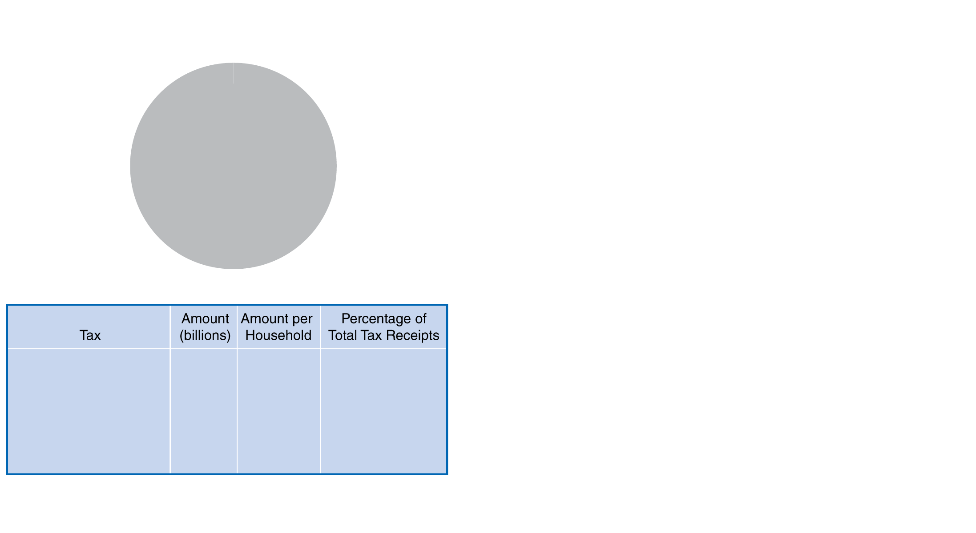
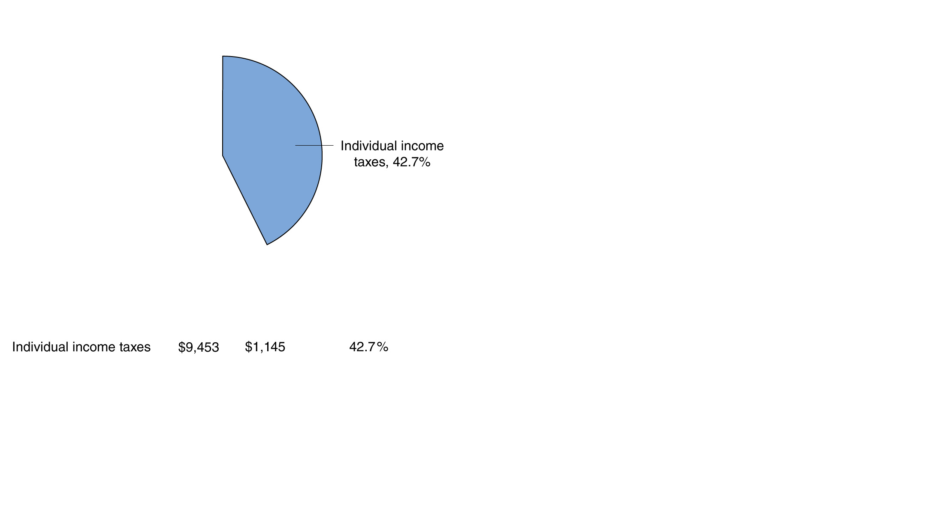
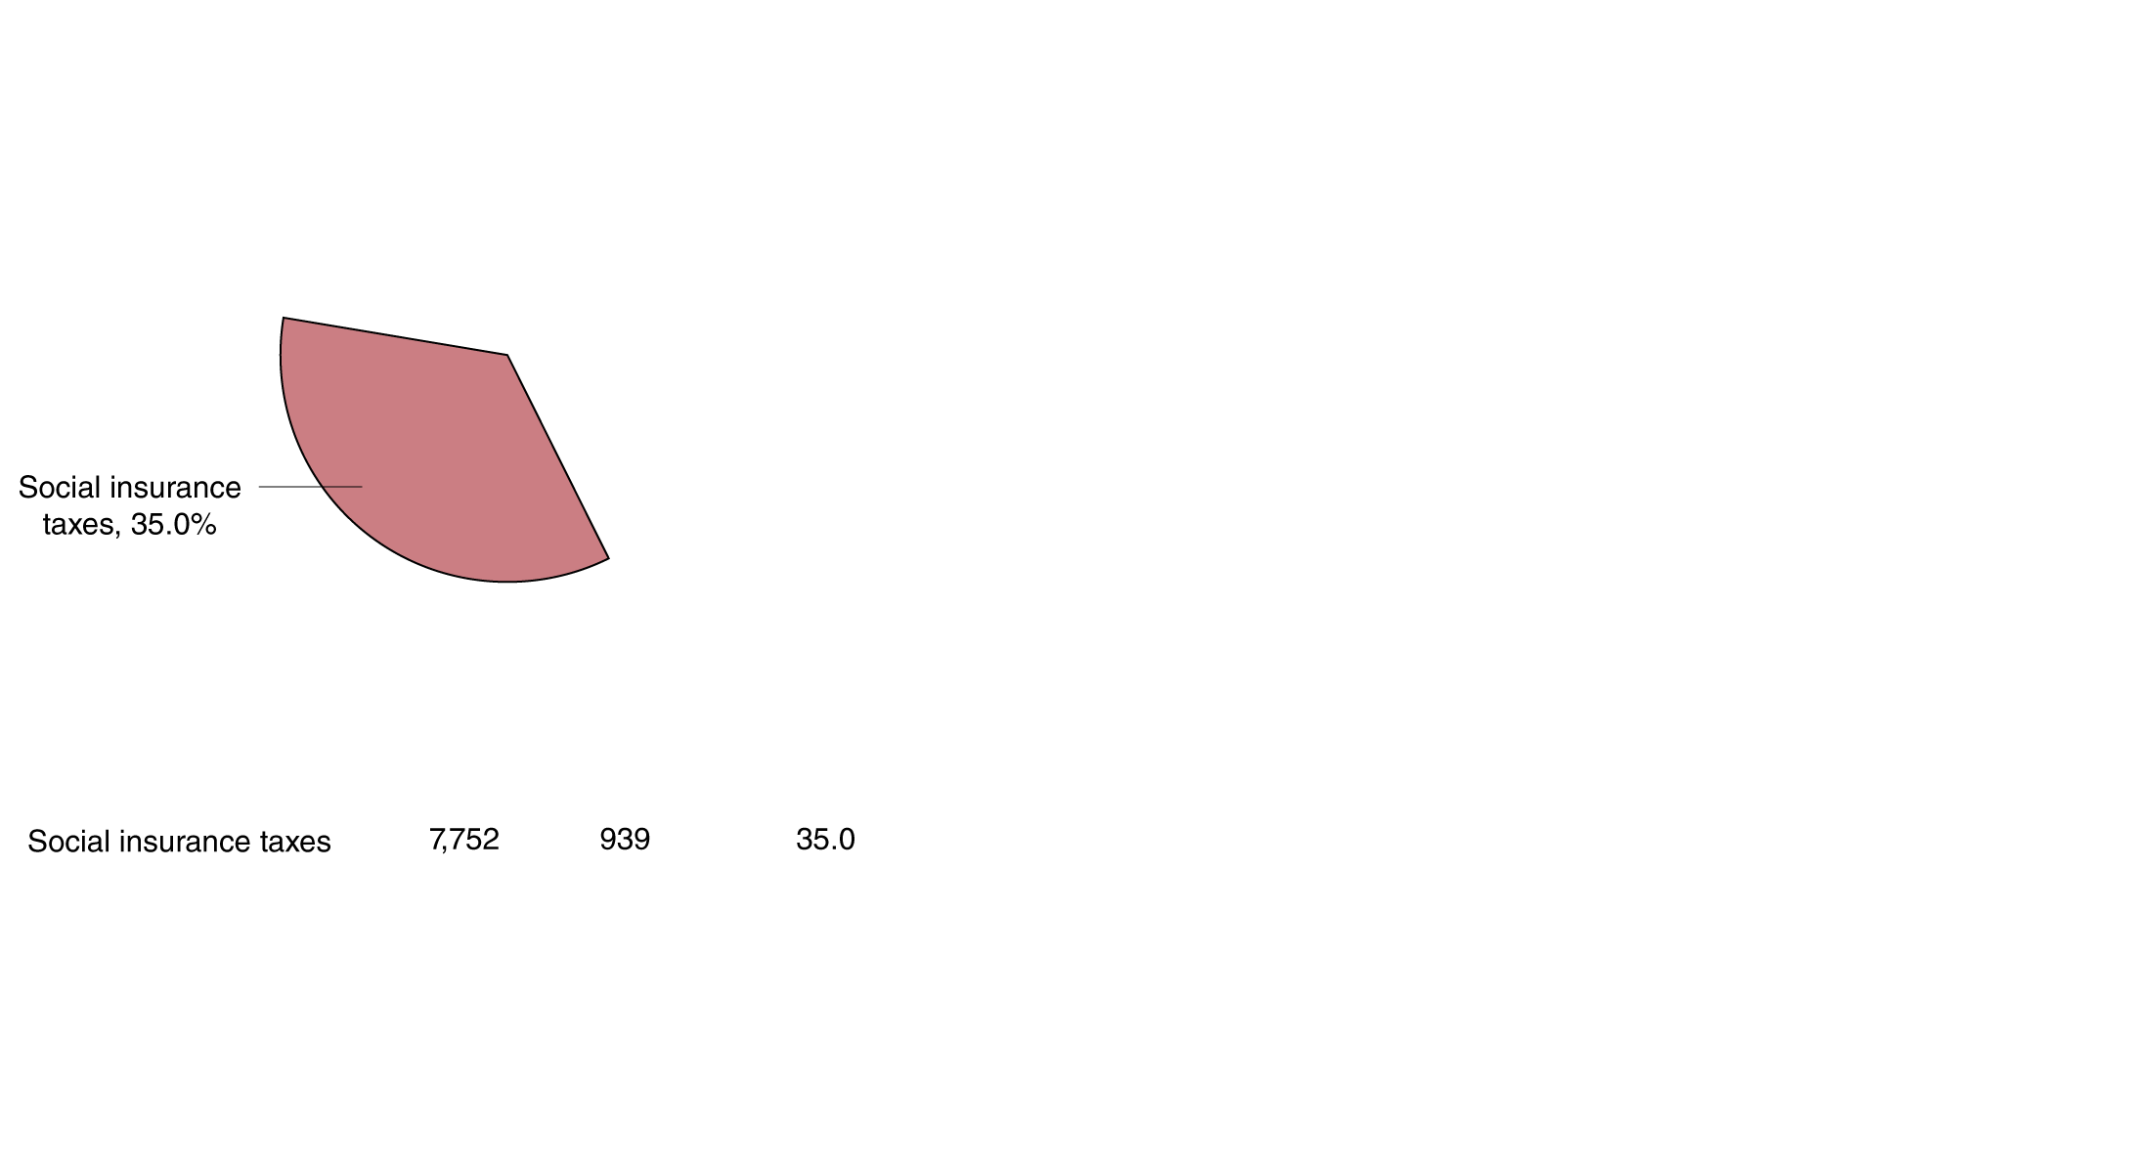
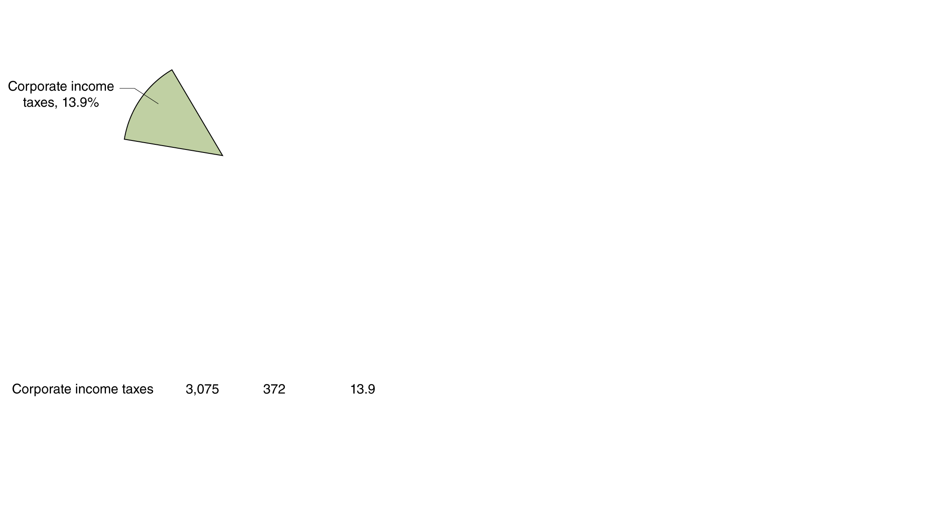
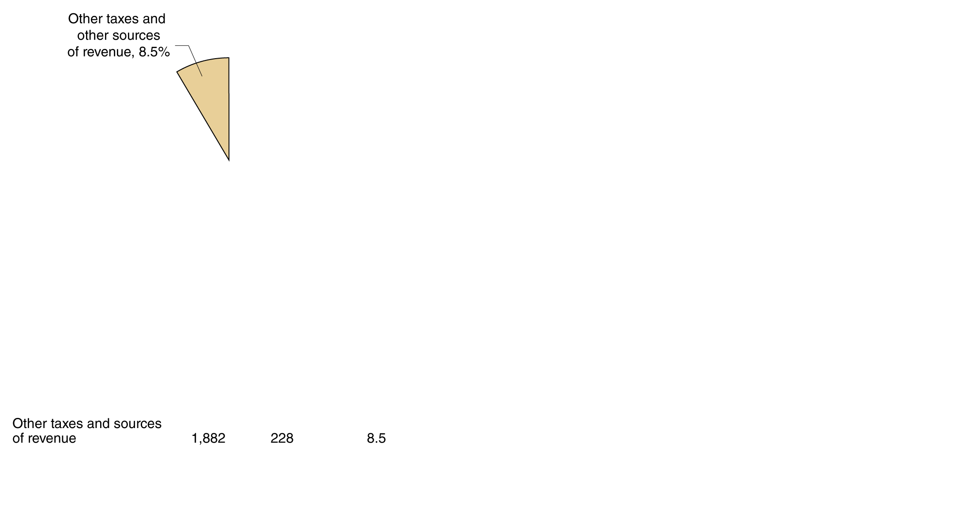

Federal government revenue sources, 2012
Social insurance (Social Security and Medicare) taxes and individual income taxes constitute the majority of the Federal government’s tax revenue.
Corporate income taxes are relatively less important, as are excise taxes (taxes on specific goods like gasoline).
(a) Sources of federal government revenue, 2012
Figure 18.2a
Federal, state, and local sources of revenue, 2012
Notes:
Individual income taxes are the most important source of revenue for the
federal government, and social insurance taxes are the second most important
source. State and local governments receive most of their revenue from
sales taxes. State and local governments also receive large transfers from the
federal government, in part to help pay for federally mandated programs.
Many local governments depend
on property taxes to raise most of their tax
revenue.
Note: Categories may not sum to totals because of rounding.
Source: U.S. Department of Commerce, Bureau of Economic Analysis, “National
Income and Product Accounts of the United States,” Tables 3.2 and 3.3, June 26, 2013.

Slide 17
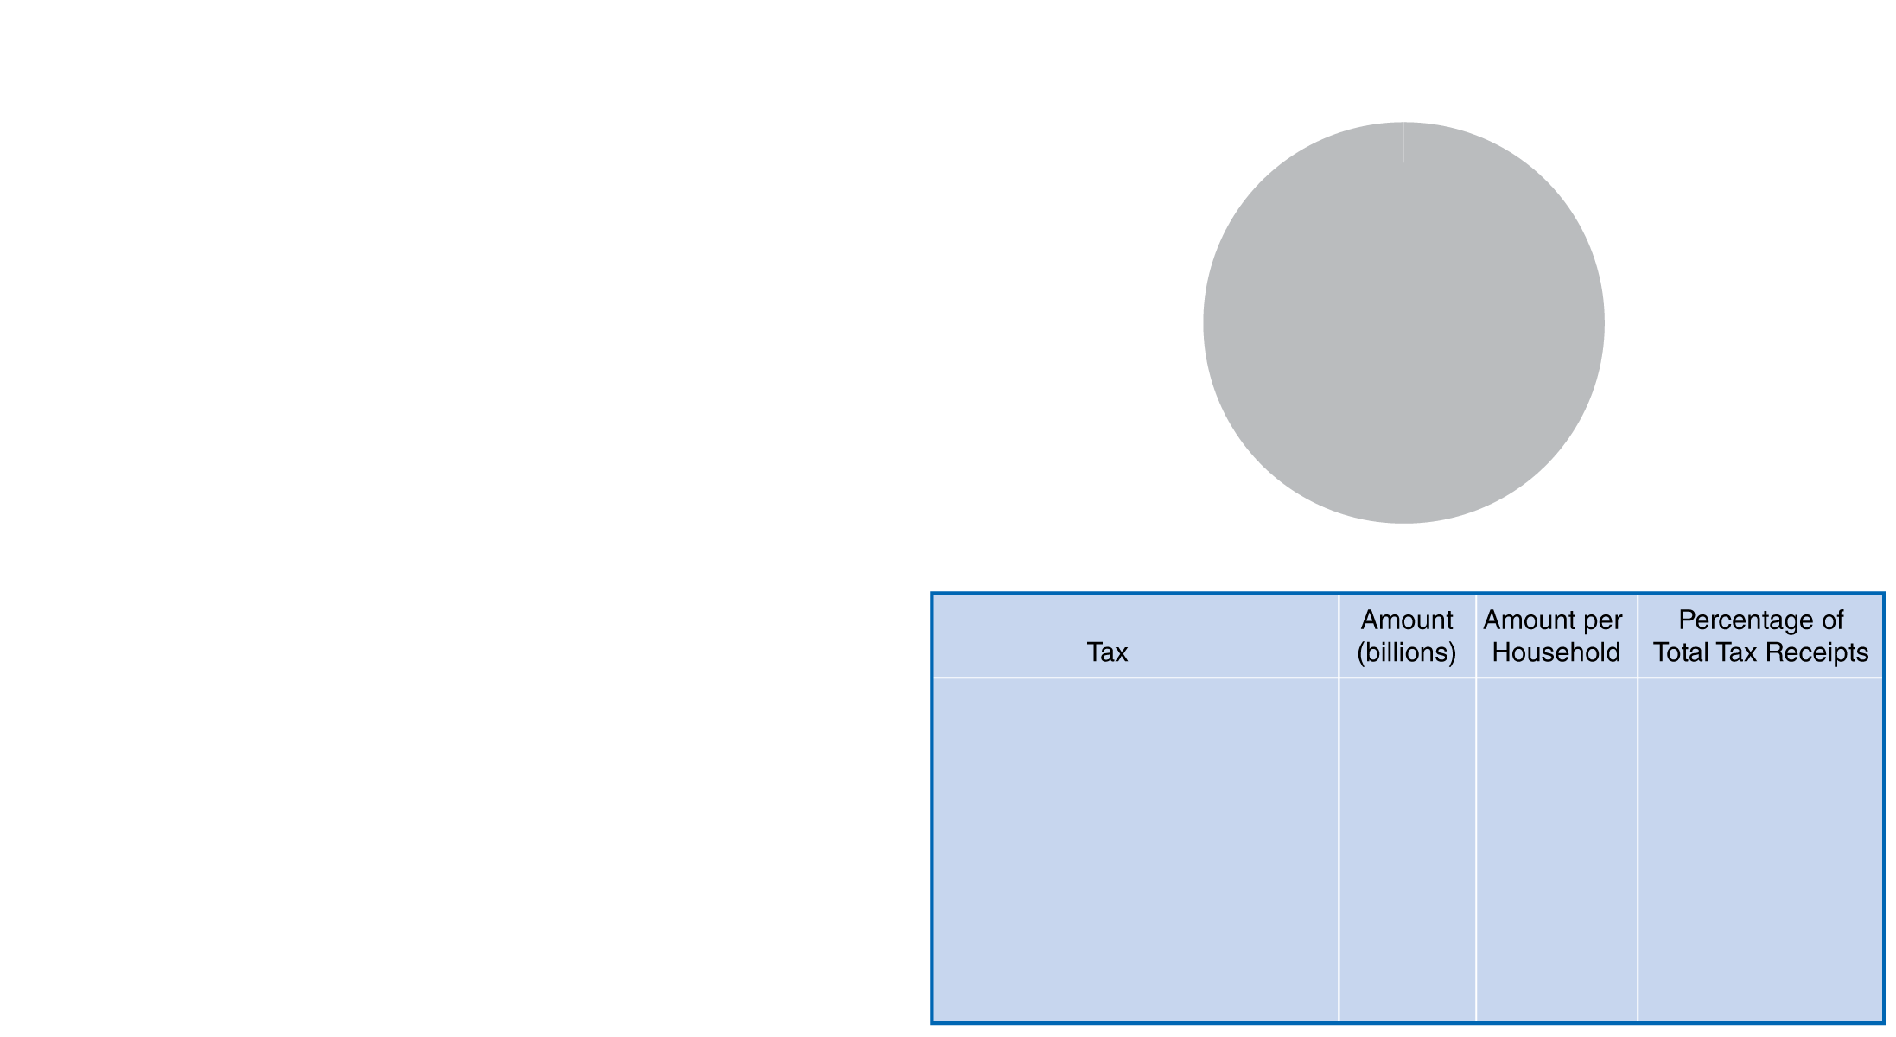
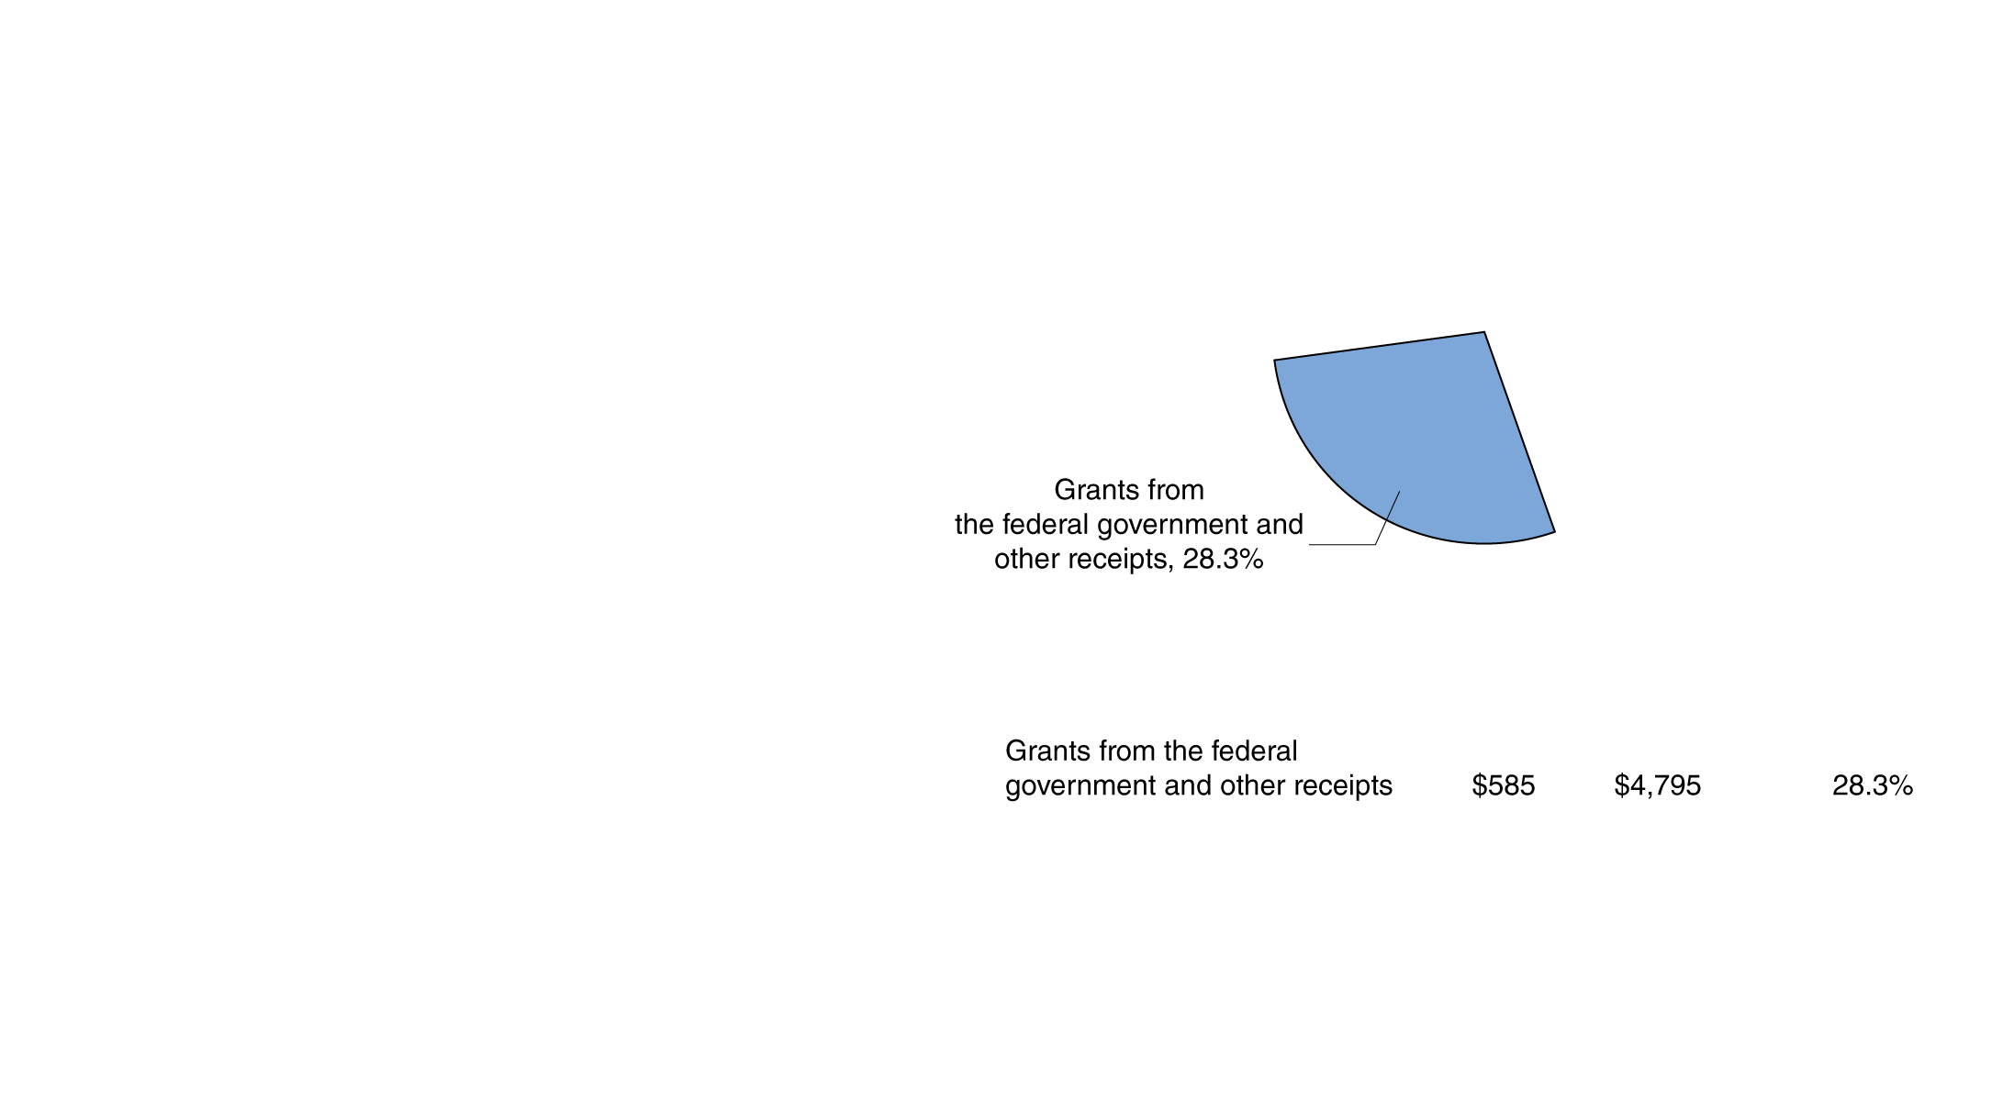
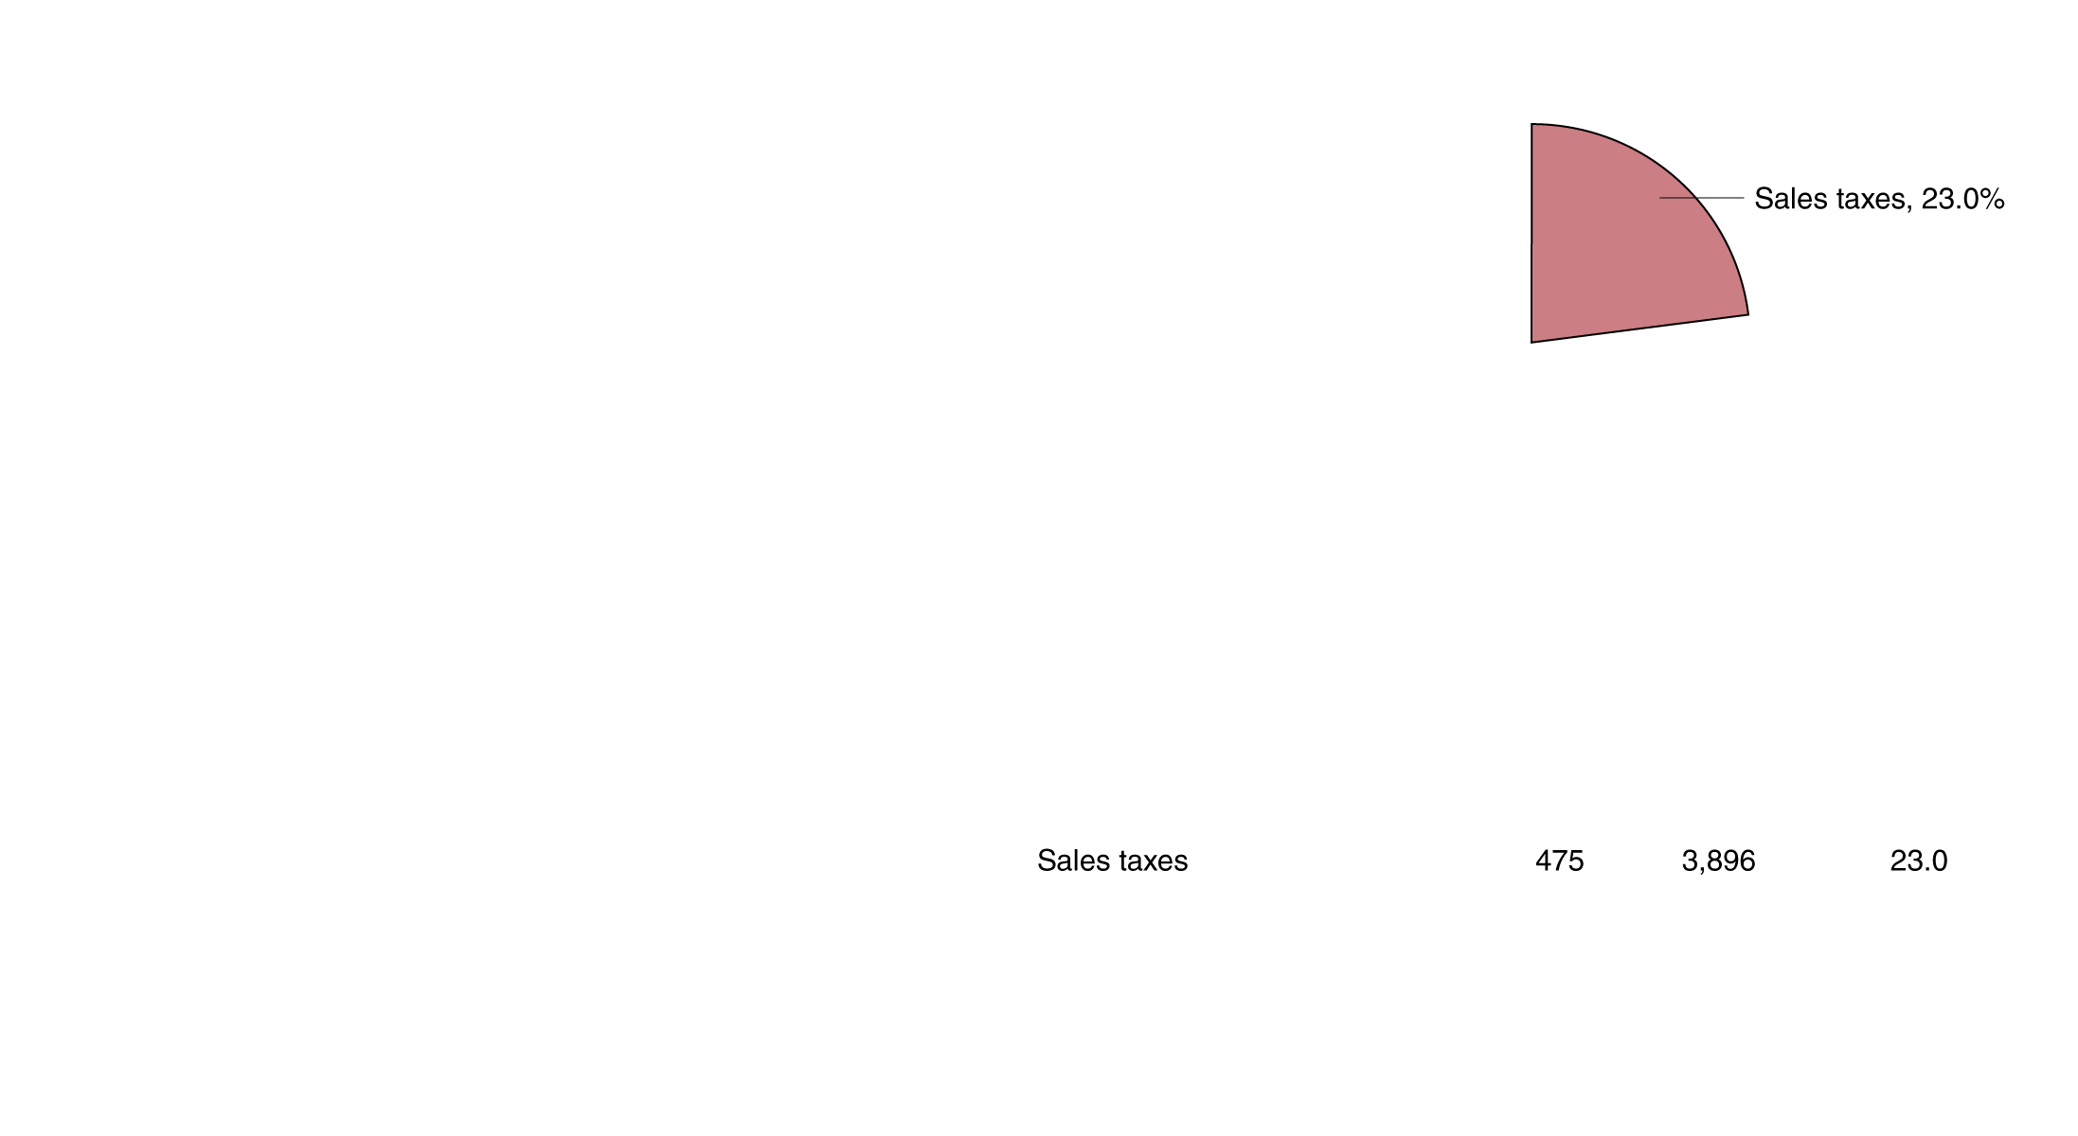
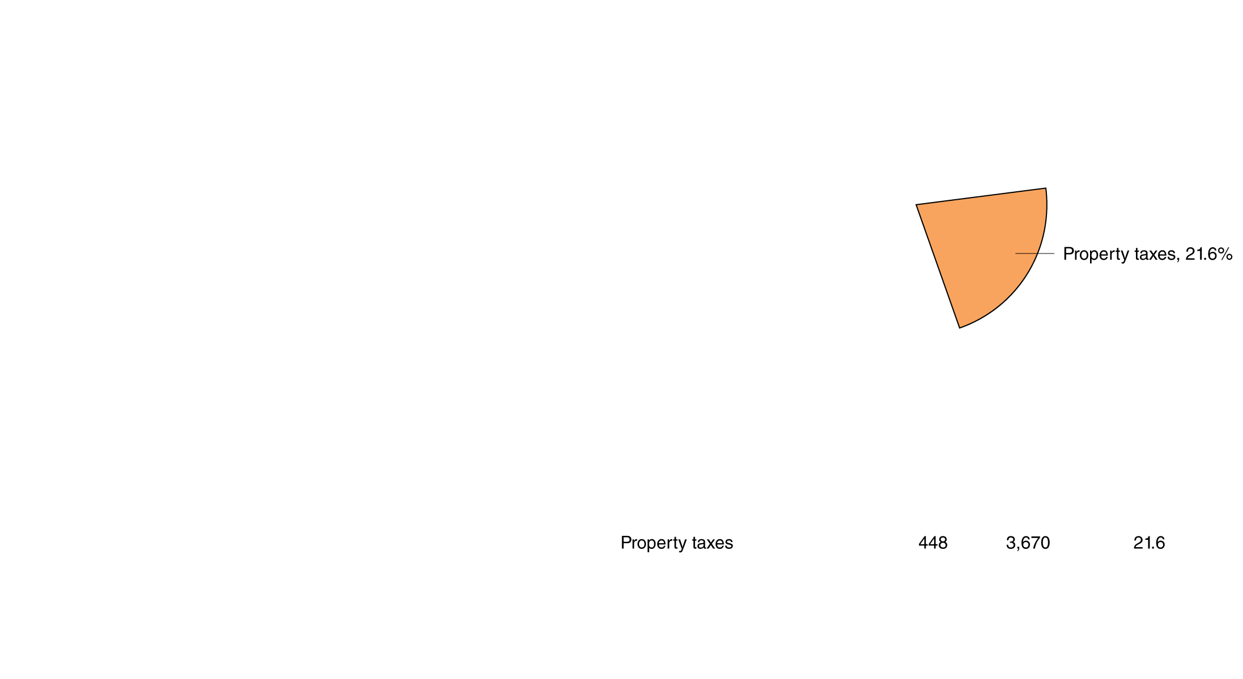
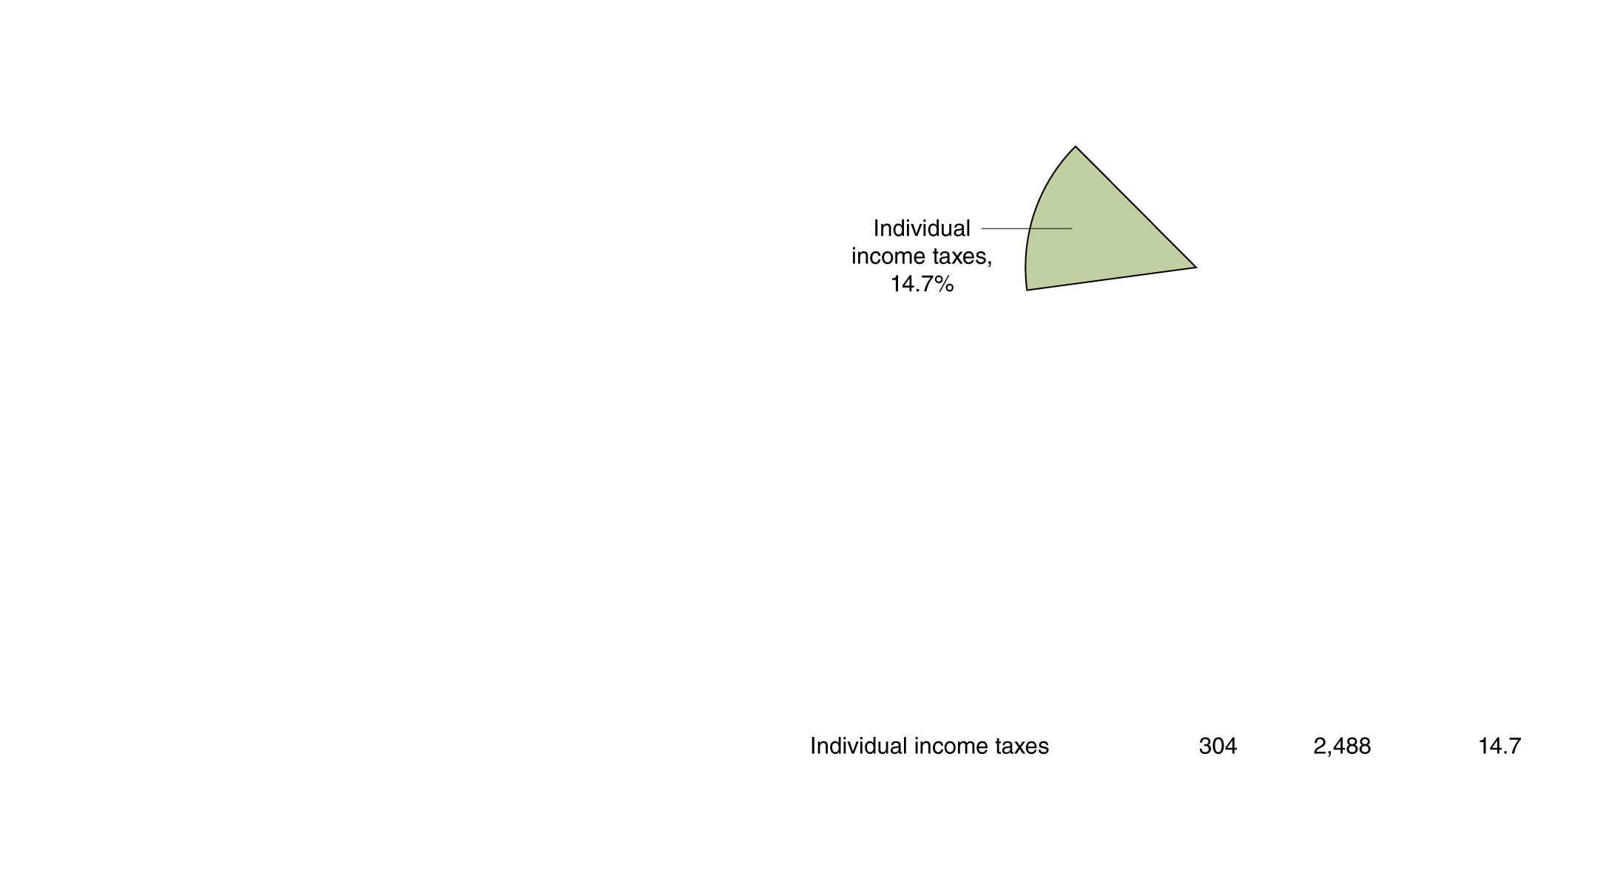
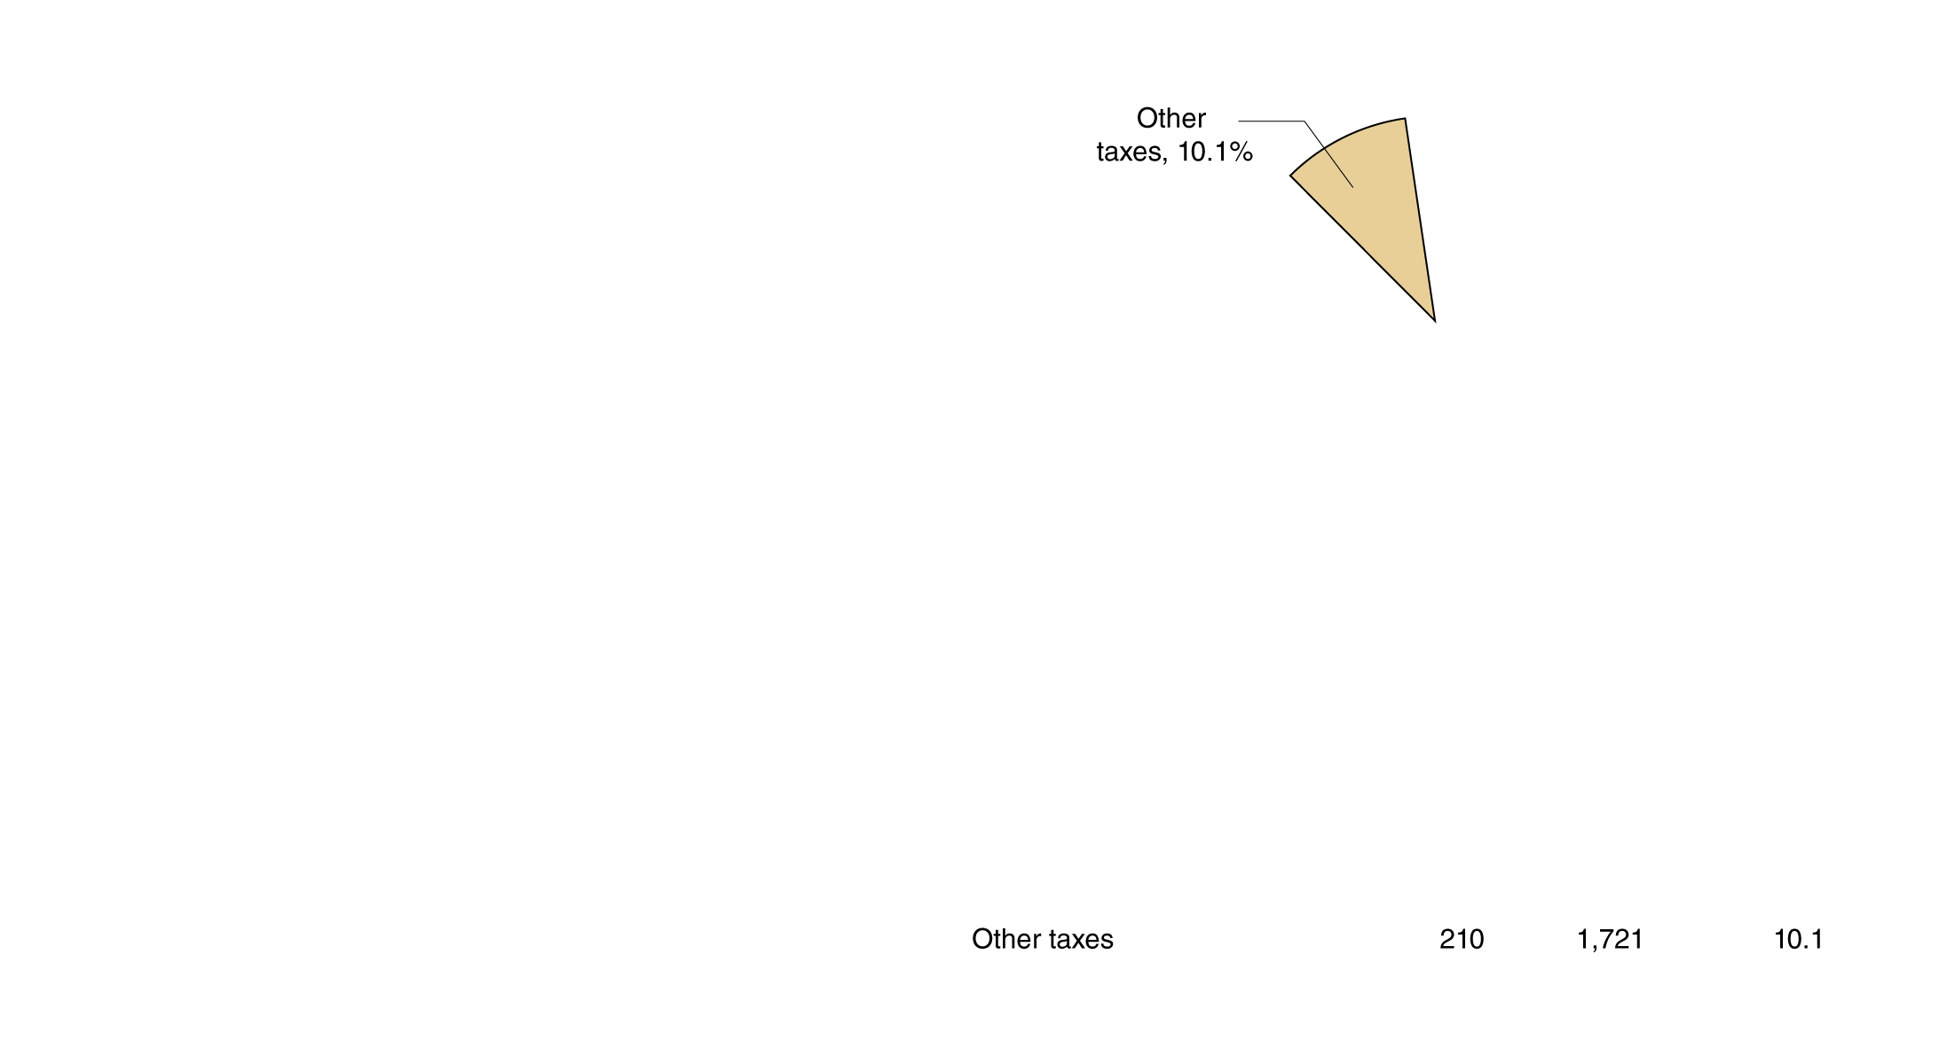
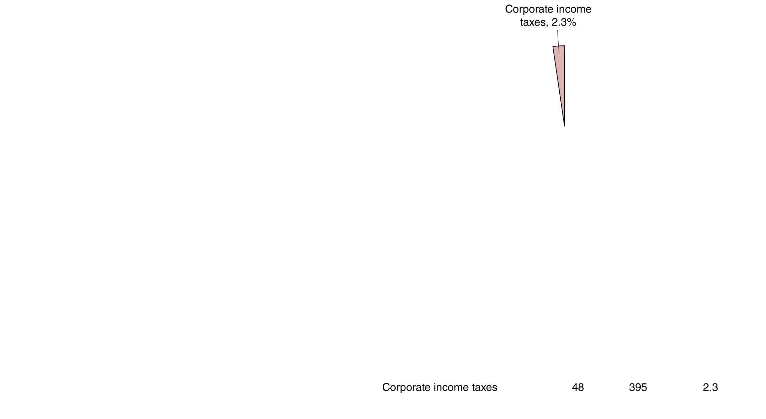

State and local government revenue sources, 2012
The sources of revenue for state and local governments are more varied.
Income taxes are less prevalent; instead, sales taxes (on goods and services) and property taxes (on land and improvements) are used.
Grants from the federal government to pay for federally-mandated programs are a significant source of revenue for states.
(b) Sources of state and local government revenue, 2012
Figure 18.2b
Federal, state, and local sources of revenue, 2012

Slide 18
Social insurance programs
An important role of government is to assure minimum levels of income to needy groups.
Social security provides cash payments to elderly retired workers, the disabled, and widows/widowers with children
Medicare is a form of medical insurance for the elderly
Medicaid provides health care to poor people
Temporary Assistance for Needy Families (TANF) provides various forms of financial assistance for a limited time to poor families
The first two programs are administered by the federal government; the latter two are administered by states, but are federally mandated and funded through federal grants.

Slide 19
Classifications of taxes
A tax is said to be regressive if people with lower incomes pay a higher percentage of their income in tax than people with higher incomes.
A tax is said to be progressive if people with lower incomes pay a lower percentage of their income in tax than people with higher incomes.
Taxes that constitute the same percentage of income for lower- income people as for higher-income people are proportional.
While some particular taxes are regressive or proportional, taxes overall in the U.S. are generally progressive.

Slide 20
Federal income tax
Federal income taxes are progressive, with successively higher marginal tax rates on income in succeeding tax brackets (ranges in which the rates apply), resulting in an increasing average tax rate.
The table shows the tax rates within each bracket, in 2011, for a single taxpayer.
Taxes are paid on adjusted gross income, calculated by subtracting exemptions and deductions from your actual income.
Income | Tax Rate
0–$8,925 | 10%
$8,926–$36,250 | 15
$36,251–$87,850 | 25
$87,851–$183,250 | 28
$183,251–$398,350 | 33
$398,351–$400,000 | 35
Over $400,000 | 39.6
Table 18.2
Federal income tax brackets and tax rates for single taxpayers, 2013

Slide 21
Federal income tax for a particular taxpayer
Assume Matt earns $100,000 in adjusted gross income.
Matt will pay 10% tax on the first $8,925, …, and 28% tax on the last $12,500 of his AGI.
Matt’s average tax rate is 21.29%.
On Matt’s . . . | Matt pays tax of . . .
first $8,925 of income | $892.50
next $27,325 of income | 4,098.75
next $51,600 of income | 12,900.00
last $12,150 of income | 4,592.00
His total federal income tax payment is | $21,293.25
Table 18.3
Federal income tax paid on taxable income of $100,000

Slide 22
Marginal and average tax rates
It is important to distinguish between marginal and average tax rates.
Marginal tax rate: The fraction of each additional dollar of income that must be paid in taxes.
Average tax rate: Total tax paid divided by total income.
In our prior example, Matt paid $21,293.25 in tax on $100,000 income; so his average tax rate was 21.29%.
But he was in the 28% tax bracket; his marginal tax rate was 28%.
Economists tend to concentrate on marginal tax rates, since these are most relevant for labor supply decisions: they apply to any additional income that people earn.

Slide 23
Which group pays the most in federal taxes?
Are federal income taxes truly progressive? The deductions available could conceivably make them not so.
Income Category | Share of Total Income Earned (1) | Share of Total Federal Taxes Paid (2) | All Federal Taxes Paid as a Fraction of Income (Average Federal Tax Rate) (3)
Lowest 20% | 4.2% | 0.3% | 3.8%
Second 20% | 9.9 | 4.3 | 9.5
Third 20% | 14.9 | 10.8 | 15.9
Fourth 20% | 20.0 | 17.7 | 19.3
Highest 20% | 51.5 | 66.7 | 26.1
Total | 100.0% | 100.0% | 20.9%
Highest 1% | 17.4 | 29.3 | 30.9
Note: Columns do not sum to precisely 100 percent due to rounding.
We can conclude that the federal taxes are progressive.
Whether the federal tax system should be made more or less progressive remains a source of political debate.

Slide 24
Corporate income taxes and double taxation
The federal government taxes corporations on their earnings via corporate income taxes. These are also progressive, with tax rates from 15% to 35%; but unlike for individuals, most corporate earnings are taxed at the 35% level.
Some economists argue that taxes ought to be assessed only at the individual level, rather than also at the corporate level. This would avoid “double taxation”.
Another alternative is to tax only at the corporate level, leaving income obtained via investment (“capital gains”) untaxed.

Slide 25
International comparison of corporate income taxes
The table shows corporate tax rates (including state taxes) in the United States and several comparison countries.
Many countries have been reducing their tax rates recently, in efforts to attract companies.
Country | Tax In 2000 | Tax In 2012
France | 37% | 33%
Germany | 52 | 29
Ireland | 24 | 13
Italy | 41 | 31
Japan | 42 | 38
Spain | 35 | 30
Sweden | 28 | 26
United Kingdom | 30 | 24
United States | 40 | 40
For example, Ireland has been able to attract some foreign companies like Microsoft, IBM, and Dell to locate facilities there.
Because of locating overseas, and for other reasons, many U.S. firms pay a marginal tax rate much lower than 40%.
Table 18.4
Corporate income tax rates around the world

Slide 26
Evaluating taxes
In selecting which taxes to use, governments take into account the following goals and principles:
The goal of economic efficiency
The ability-to-pay principle
The horizontal-equity principle
The benefits-received principle
The goal of attaining social objectives
Each of these suggest different combinations and levels of taxes.

Slide 27
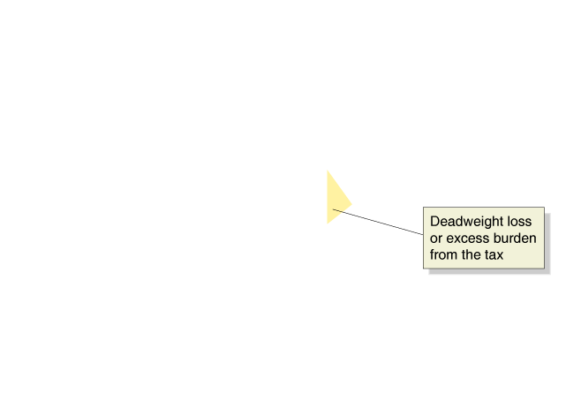
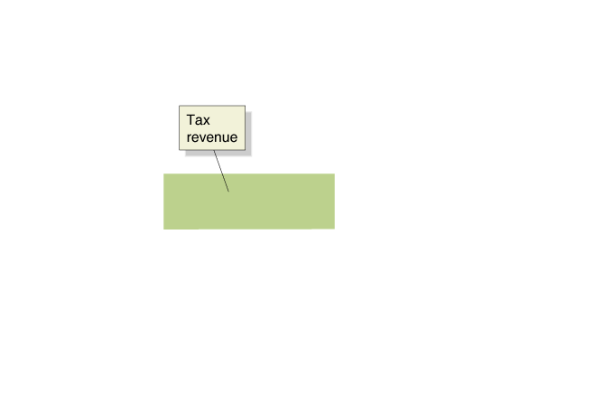
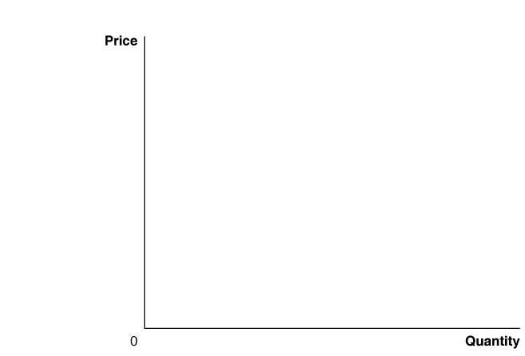
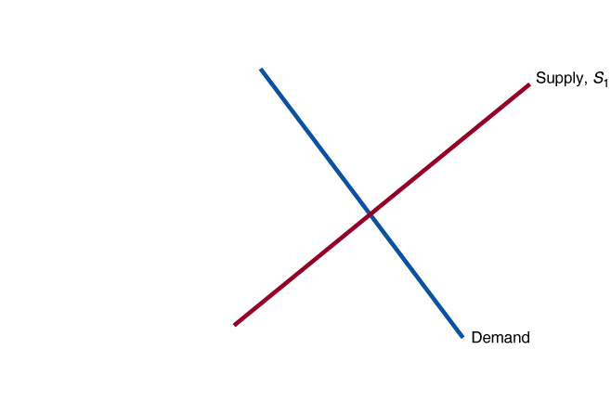
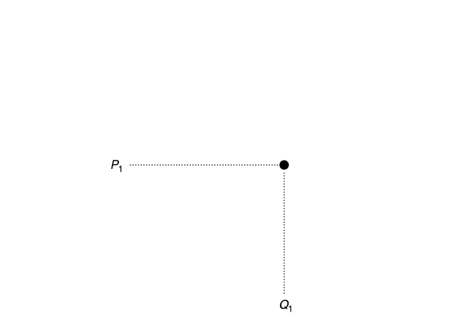
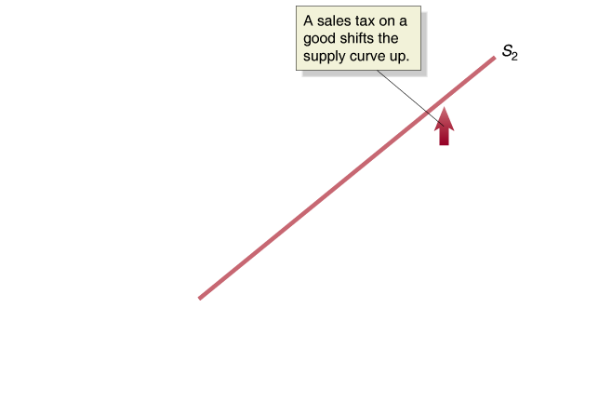
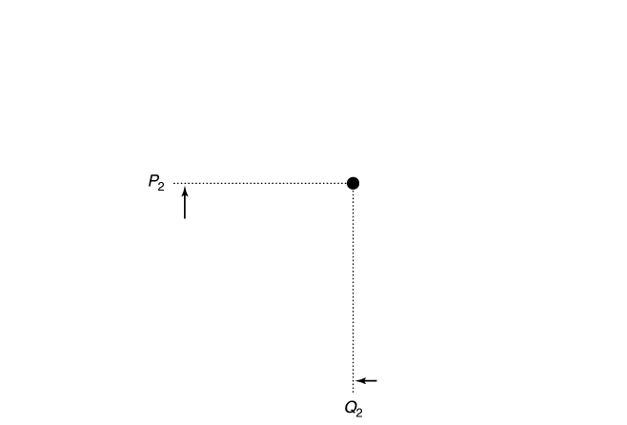
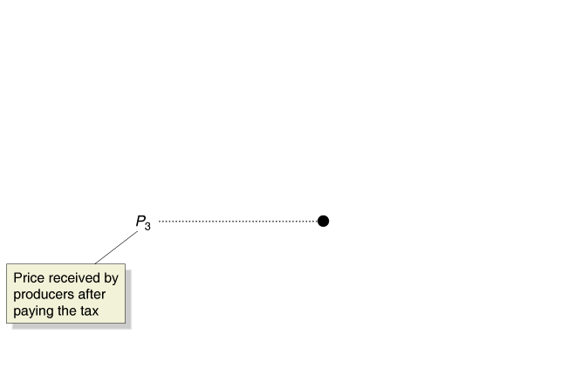
The goal of economic efficiency
In the tax literature, deadweight loss resulting from a tax is known as excess burden.
Excess burden: A measure of the efficiency loss to the economy that results from a tax having
reduced the quantity of a
good produced; also
known as deadweight loss.
A desirable feature of tax system is to have low amounts of excess burden. as deadweight loss. The figure shows excess burden from a sales tax.
Figure 18.3
The efficiency loss from a sales tax
Notes:
This figure reviews the discussion of the efficiency
loss from a tax (see Chapter 4). A sales
tax increases the cost of supplying a good,
which causes the supply curve to shift up, from
S1 to S2. Without the tax, the equilibrium price
of the good is P1, and the equilibrium quantity
is Q1. After the tax is imposed, the equilibrium
price rises to P2, and the equilibrium quantity
falls to Q2. After paying the tax, producers receive
P3. The government receives tax revenue
equal to the green-shaded rectangle. Some
consumer surplus and some producer surplus
become tax revenue for the government, and
some become deadweight loss, shown by the
yellow-shaded triangle. The deadweight loss is
the excess burden of the tax.

Slide 28
Relative size of excess burden
Excess burden will be large relative to the tax revenues if the quantity changes a lot in response to the tax.
This relates to the elasticity of supply and demand: high elasticities lead to high excess burdens.
Economists are especially concerned about whether high tax rates on income lead people to work less. For example, in Europe, tax rates on income are high, and people work less than in America.
Figure 18.3
The efficiency loss from a sales tax

Slide 29
The ability-to-pay principle
The ability-to-pay principle holds that revenue from taxes ought to mostly be paid by the rich—that is, those who have a higher ability to pay.
In practice, this means that people with higher incomes end up paying more taxes, a concept known as vertical equity.
Income and wealth do correlate, but not perfectly.
Income taxes are progressive, reflecting the ability-to-pay principle.
However sales taxes are regressive, since consumption constitutes a larger proportion of income for the poor than the rich; so these go against the ability-to-pay principle.

Slide 30
The horizontal equity principle
The horizontal-equity principle holds that people in the same economic situation ought to pay similar amounts in taxes.
This is not easy to apply in practice.
If two people each earn $50,000, horizontal-equity seems to suggest taxing each the same amount.
But if one receives the income by working two 40-hour a week jobs, while the other receives the income from a lottery annuity, these two people do not seem to be in the “same economic situation”.

Slide 31
The benefits-received principle
The benefits-received principle holds that governments ought to charge more in taxes to people receiving more benefits from taxes.
Funding locally-operated services like snow-plowing and road-maintenance at the local town or county level follows the benefits-received principle.
However some government services are designed to help poor people; taxing those people to pay for those services is probably counter-productive.
Similarly, it is often difficult to identify exactly which groups are helped by particular government activities.
Example: How would we divide the benefits from national defense?

Slide 32
The goal of attaining social objectives
Taxes are sometimes used to attain social objectives.
For example, alcohol and cigarettes are often seen as undesirable for people to consume. So governments tend to tax these goods relatively highly, in order to discourage their consumption.
Such taxes are known as sin taxes.

Slide 33
Tax Incidence Revisited: The Effect of Price Elasticity
18.3
Understand the effect of price elasticity on tax incidence.

Slide 34
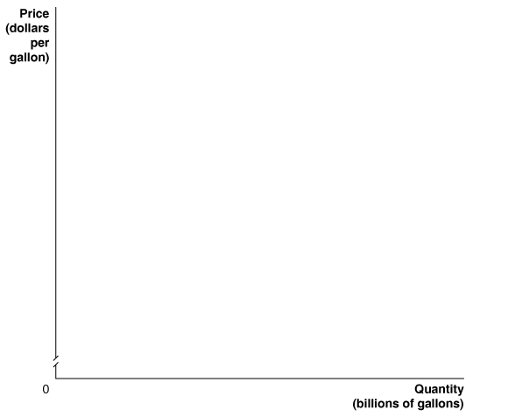
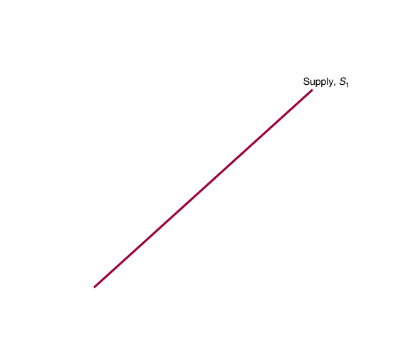
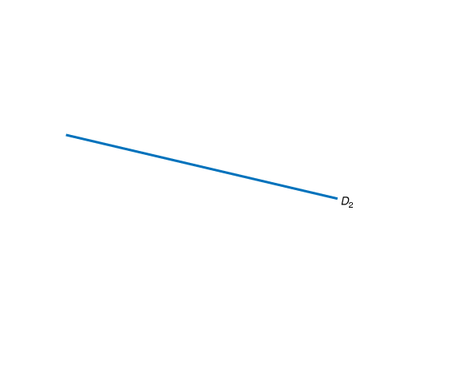
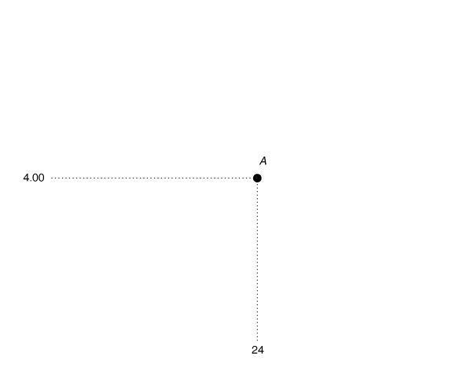
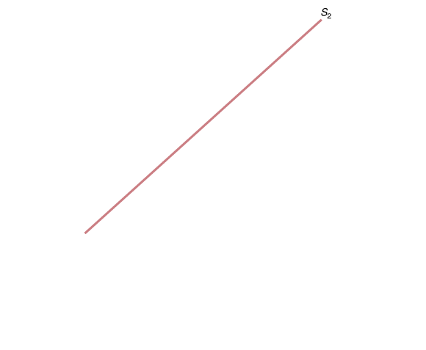
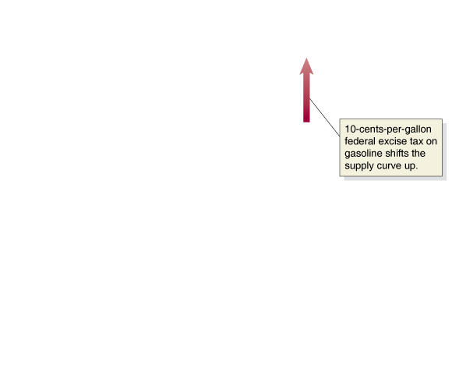
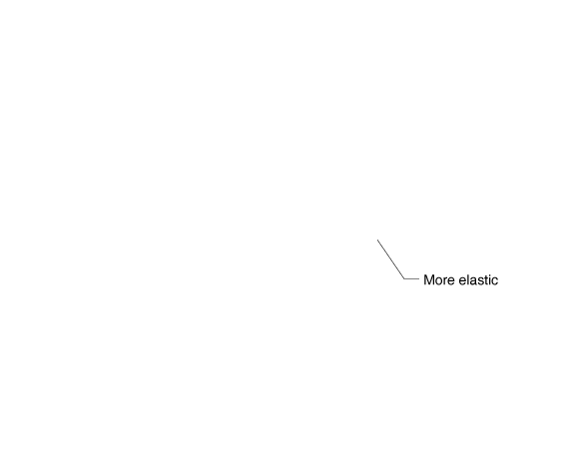
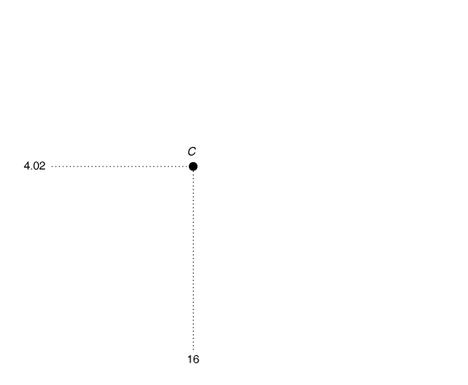
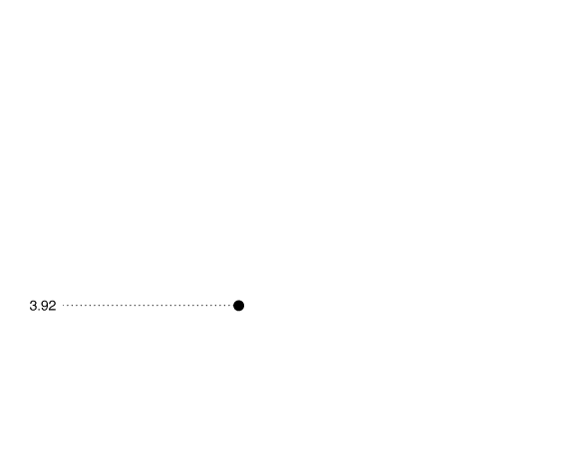
Tax incidence
Recall that while taxes may be legally assessed on buyers or on sellers, the tax incidence is generally shared.
Tax incidence: The actual division of the burden of a tax between buyers and sellers in a market.
The figure shows a 10-cents-per-gallon tax on gasoline.
While this is legally assessed on sellers, the price buyers pay increases 2 cents; buyers have 20% of the burden of this tax.
Figure 18.4
The effect of elasticity on tax incidence
Notes:
When demand is more elastic than supply,
consumers bear less of the burden of a tax.
When supply is more elastic than demand,
firms bear less of the burden of a tax. D1
is inelastic between points A and B, and
D2 is elastic between points A and C. With
demand curve D1, a 10-cent-per-gallon
tax raises the equilibrium price from $4.00
(point A) to $4.08 (point B), so consumers
pay 8 cents of the tax, and firms pay 2
cents. With D2, a 10-cent-per-gallon tax on
gasoline raises the equilibrium price only
from $4.00 (point A) to $4.02 (point C), so
consumers pay 2 cents of the tax. Because in
this case producers receive $3.92 per gallon
after paying the tax, their share of the tax is
8 cents per gallon.

Slide 35
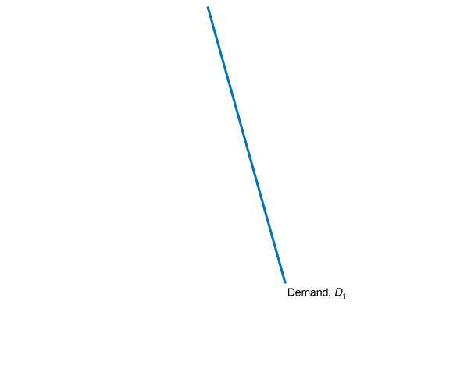
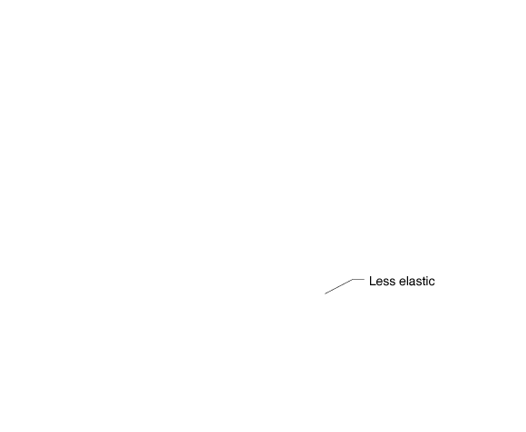
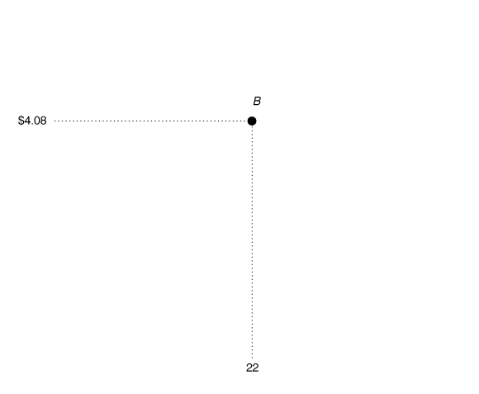
Tax incidence and elasticity
However if buyers had less price-elastic demand for gasoline, they would adjust their purchases less in response to price changes.
In this case, the price buyers pay ends up increasing by 8 cents; buyers pay 80% of the tax, effectively.
Tax incidence is determined by the relative price elasticities of the demand and supply curves.
Figure 18.4
The effect of elasticity on tax incidence

Slide 36

Who really feels the burden of corporate income taxes?
While corporations are not actually people, they are owned by people and sell products to people; so all taxes assessed on corporations are eventually paid by people, whether through lower earnings or higher prices.
Taxes on corporate income also discourage investment in corporations, reducing the capital available to firms, and hence also worker productivity—and wages.
In fact, the Congressional Budget Office estimates that the excess burden from corporate income taxes may be half as large as the tax revenues generated, making it a very inefficient form of tax.

Slide 37
Income Distribution and Poverty
18.4
Discuss the distribution of income in the United States and understand the extent of income mobility.

Slide 38
Income inequality
There are always relatively rich and relatively poor people within every society.
Whether or not there is a best amount of inequality is an open (and very much normative) question.
More straightforward is to ask:
How has the income distribution in the United States changed over time?
How do tax systems affect the income distribution?
How does the income distribution in the United States compare with other countries?

Slide 39
Income inequality in the United States
The first table shows income in various brackets in 2009.
Without context, it is hard to evaluate.
We can achieve some context by considering how the income distribution has changed over time: the second table.
Annual Income | Percentage of All Households
$0–$14,999 | 13.0%
$15,000–$34,999 | 22.4
$35,000–$49,999 | 13.6
$50,000–$74,999 | 17.5
$75,000–$99,999 | 11.7
$100,000–$199,999 | 17.5
$200,000 and over | 4.5
Table 18.5
The distribution of household income in the United States, 2012
Year | Lowest 20% | Second 20% | Third 20% | Fourth 20% | Highest 20%
2012 | 3.2% | 8.3% | 14.8% | 23.0% | 51.0%
2000 | 3.6 | 8.9 | 14.8 | 23.0 | 49.8
1990 | 3.9 | 9.6 | 15.9 | 24.0 | 46.6
1980 | 4.3 | 10.3 | 16.9 | 24.9 | 43.7
1970 | 4.1 | 10.8 | 17.4 | 24.5 | 43.3
1960 | 3.2 | 10.6 | 17.6 | 24.7 | 44.0
1950 | 3.1 | 10.5 | 17.3 | 24.1 | 45.0
1936 | 4.1 | 9.2 | 14.1 | 20.9 | 51.7
Table 18.6
How has the distribution of income changed over time?

Slide 40
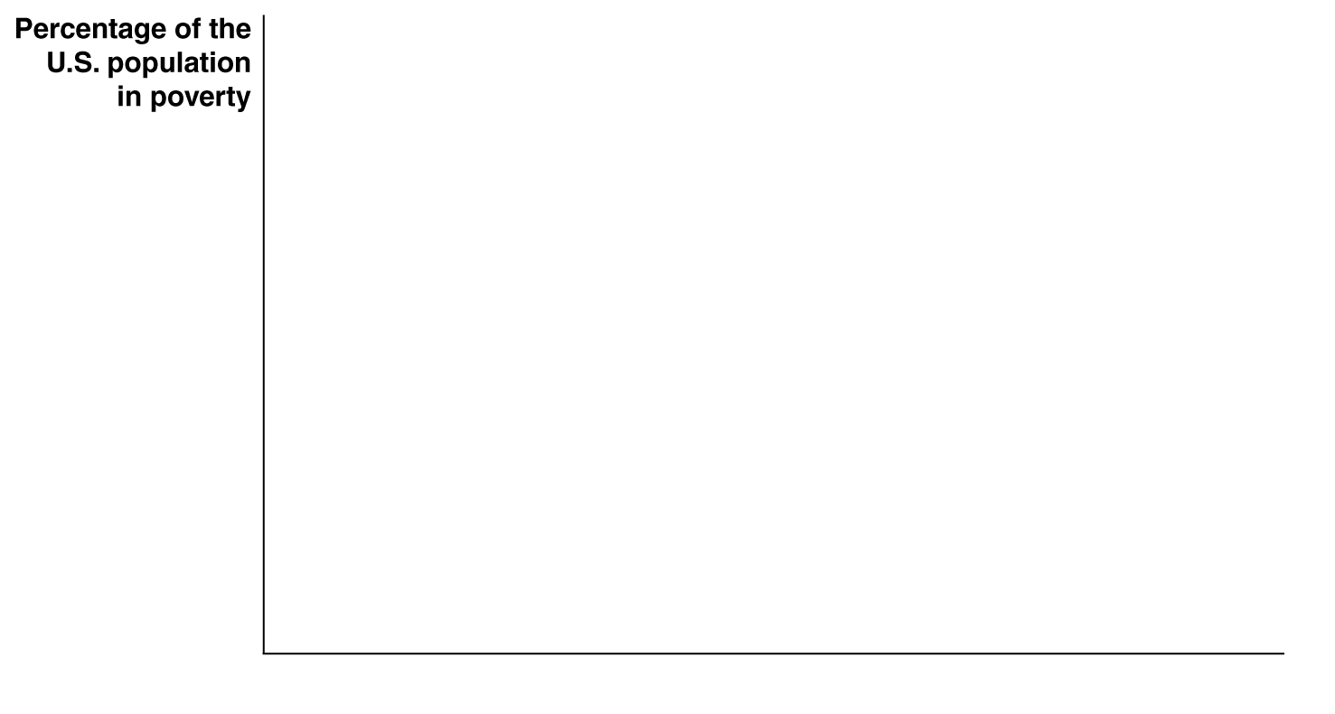

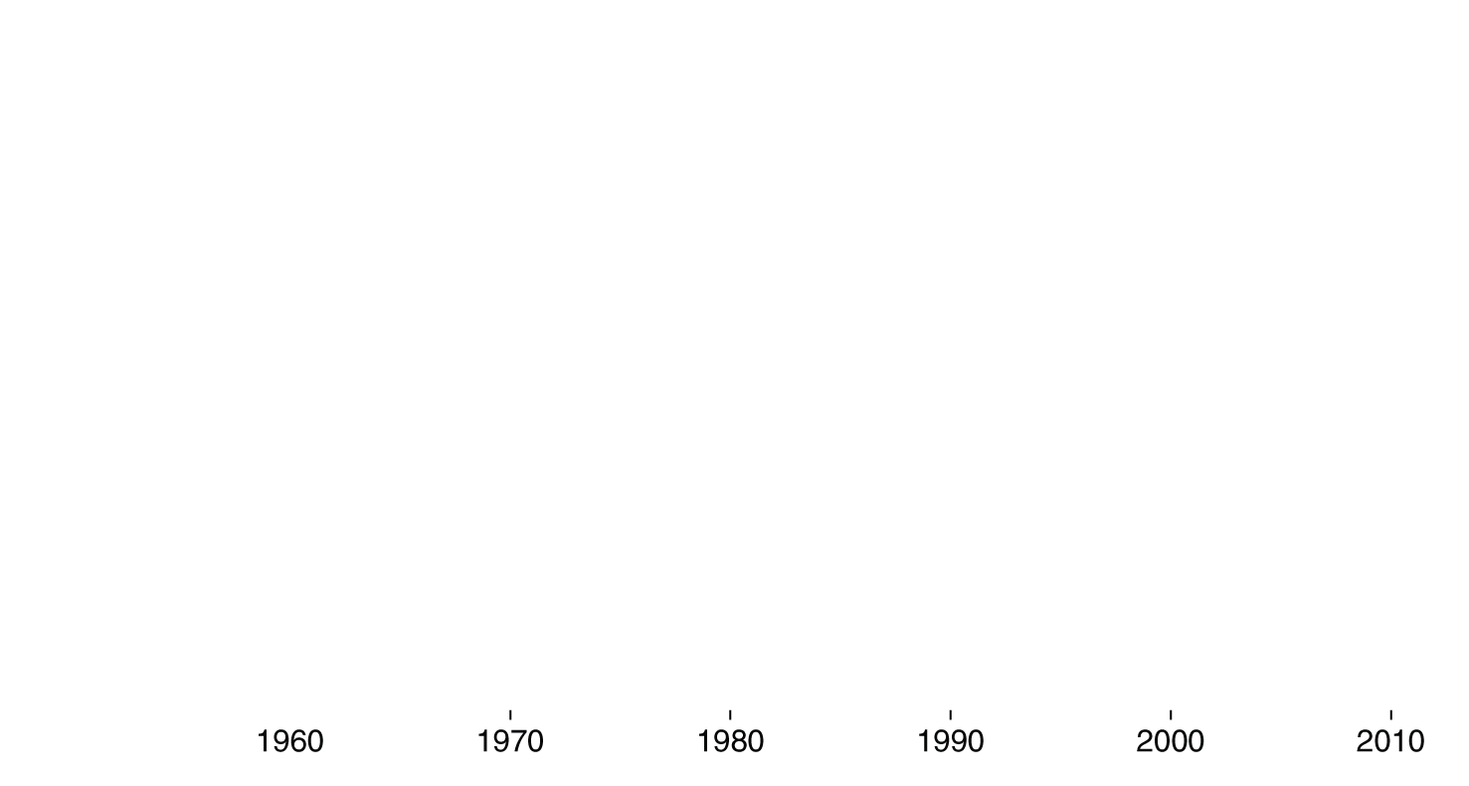

Poverty in the United States
How many Americans are “poor”? What does it
mean to be “poor”?
The federal government defines a household as “poor” if its annual cash income is below the poverty line, a level of annual income equal to three times the amount of money necessary to purchase the minimum quantity of food required for adequate nutrition.
Figure 18.5
Poverty in the United States, 1960–2012
The poverty rate (shown above) is the percentage of the population that is poor according to the federal government’s definition.
Decreases in the poverty rate in the 1960s came largely from the expansion of Social Security.
Notes:
The poverty rate in the United States declined
from 22 percent of the population in
1960 to 11 percent in 1973. Over the past
30 years, the poverty rate has fluctuated between
11 and 15 percent of the population.
Source: Carmen DeNavas-Walt, Bernadette
D. Proctor, and Jessica C. Smith, U.S. Census
Bureau, Current Population Reports, P60–245,
Income, Poverty, and Health Insurance
Coverage in the United States: 2012,
Washington, DC: U.S. Government Printing
Office, September 2013.

Slide 41
Poverty among different groups in the U.S.
The table shows poverty rates for various demographic groups in 2012.
All people | 15.0%
Female head of family, no husband present (all races) | 30.9
Blacks | 27.2
Hispanics | 25.6
Asians | 11.7
White, not Hispanic | 9.7
Married couple families (all races) | 6.3
Note: Hispanic people can be of any race.
Table 18.7
Poverty rates vary across groups, 2012

Slide 42
Explaining income inequality
The marginal productivity theory of income distribution (from chapter 17) suggests each factor of production (including labor) is paid its marginal revenue product.
A worker’s productivity depends in part on his or her human capital, the accumulated knowledge and skills that workers acquire from formal training and education or from life experiences.
Since human capital is not distributed equally across workers, neither will income be.
Similarly, ownership of other factors of production such as capital is not distributed equally either.

Slide 43
Explaining increasing income inequality
Table 18.6 showed that income inequality in the United States has been rising over the last few decades.
Some factors that help to explain this include:
Rapid technological change has decreased the demand for “unskilled” workers relative to “skilled” workers
Expanding international trade has had the same effect
Increased immigration (legal and not) has brought more unskilled workers to the United States
These also have increased the income earned by capital-owners; and since capital-owners are generally richer, this also increases income inequality.

Slide 44
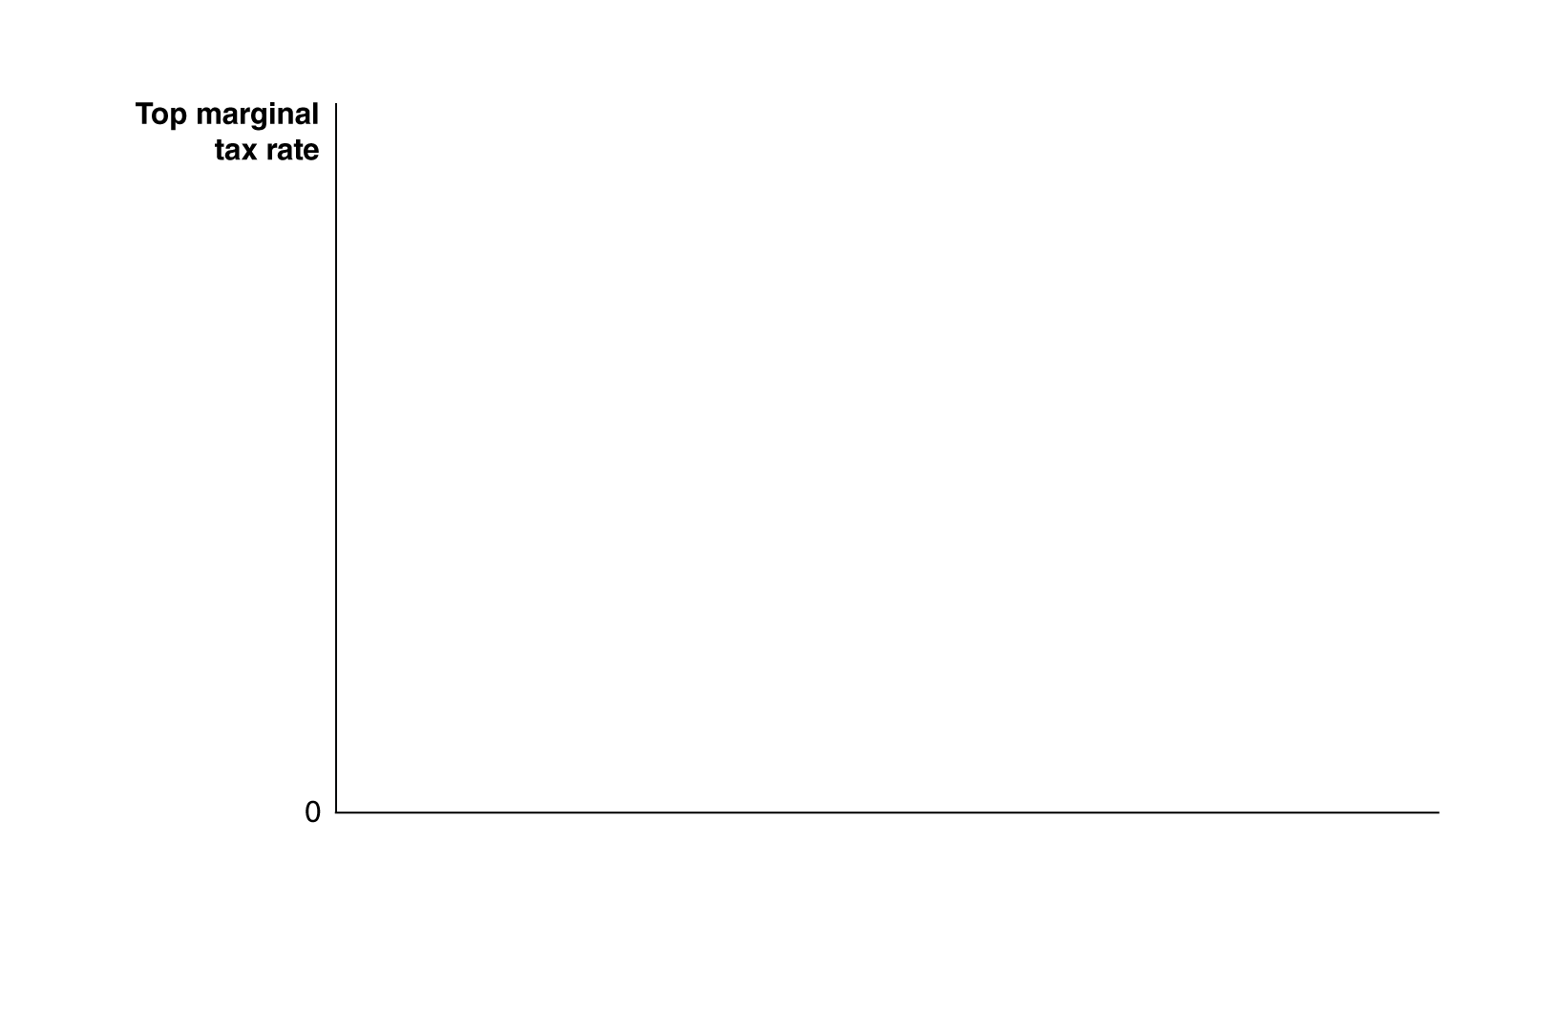

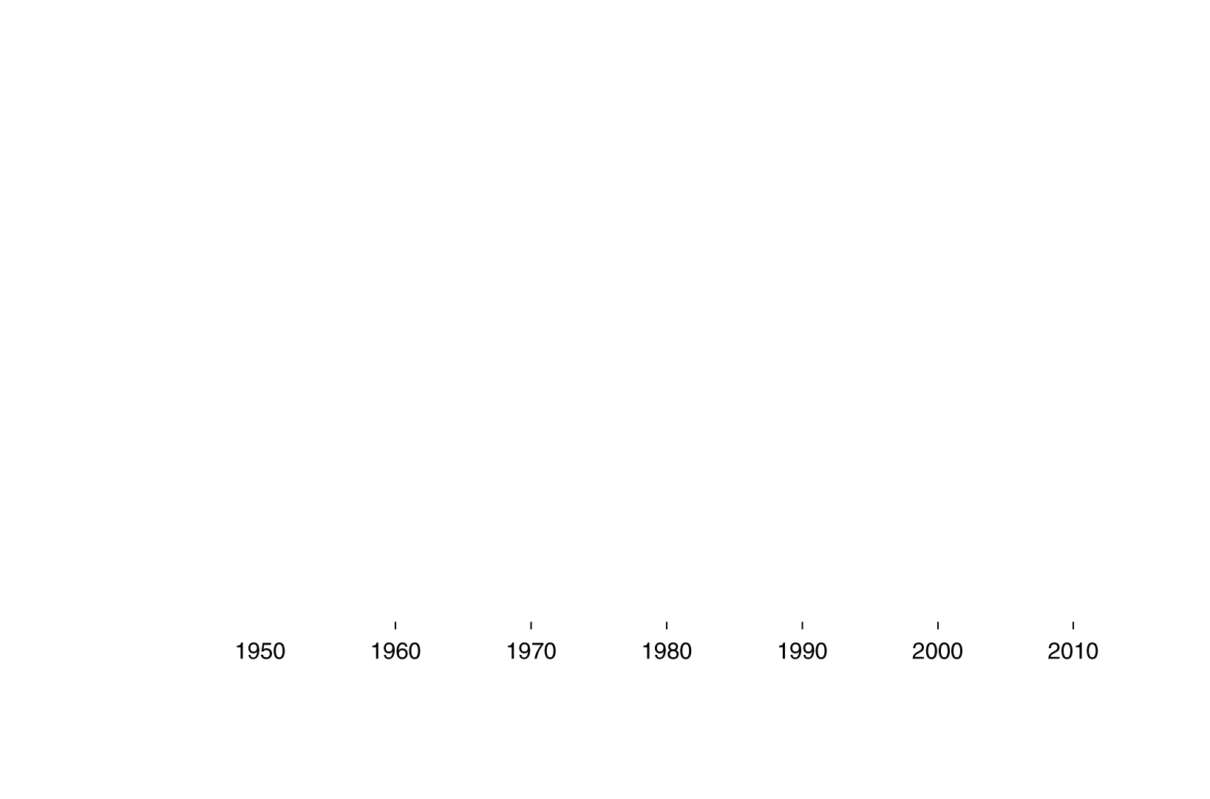

Have changing tax rates increased income inequality?
The top marginal tax rate has decreased over the last 50 years.
But it has remained relatively steady over the last 20 years, over which time income inequality has increased dramatically.
This suggests that changes in marginal tax rates are not the cause of increasing income inequality.
Figure 18.6
The top marginal income tax rate in the United States, 1950–2013
Notes:
The top marginal tax rate has varied dramatically
since 1950, while the distribution
of income has changed much less.
Sources: Urban Institute and the Brookings
Institution, Tax Policy Center.

Slide 45
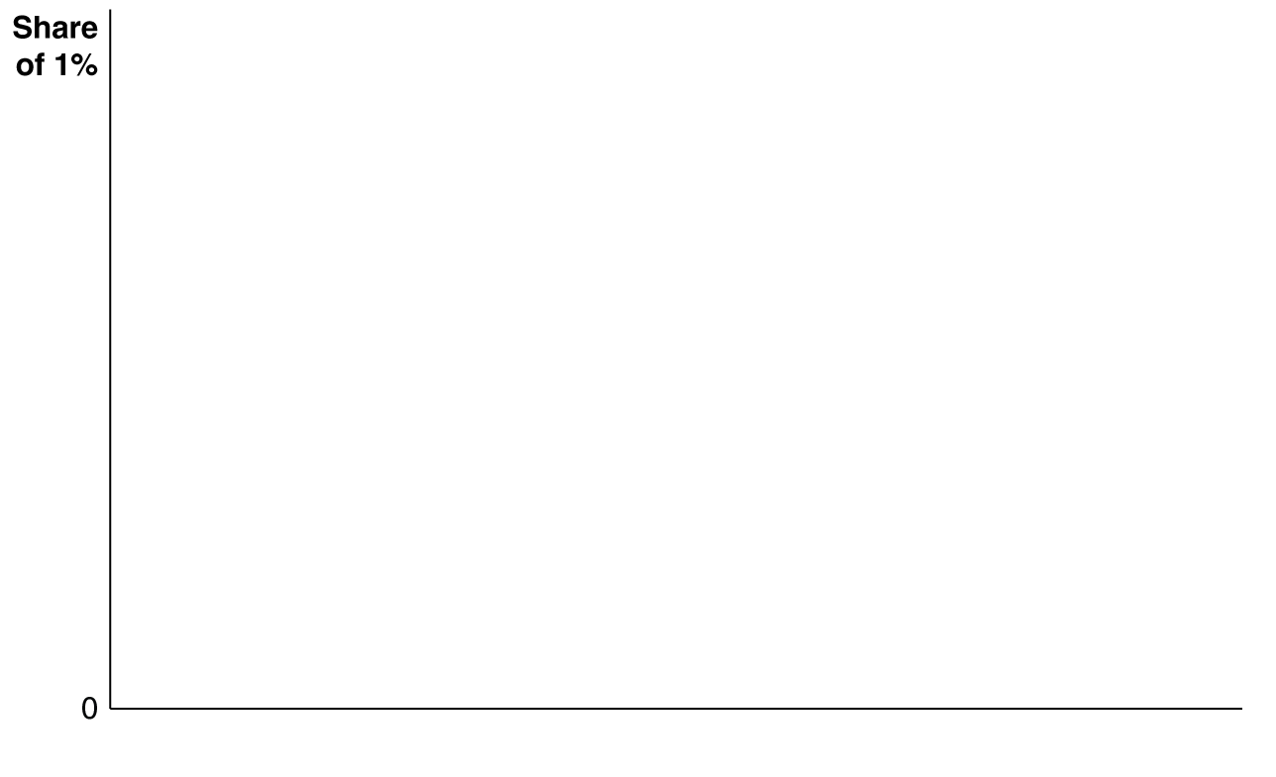

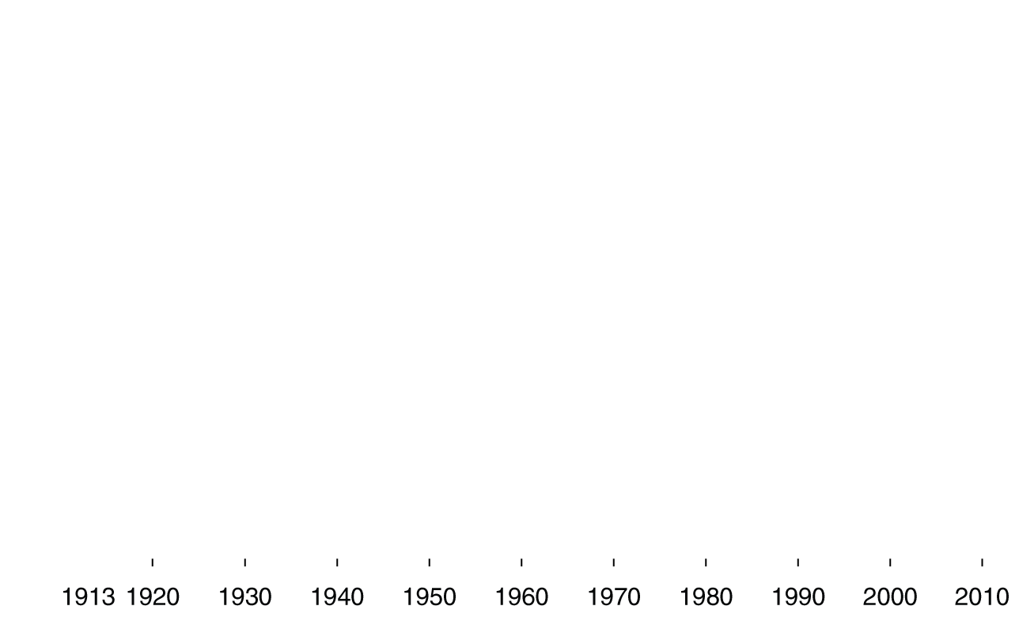
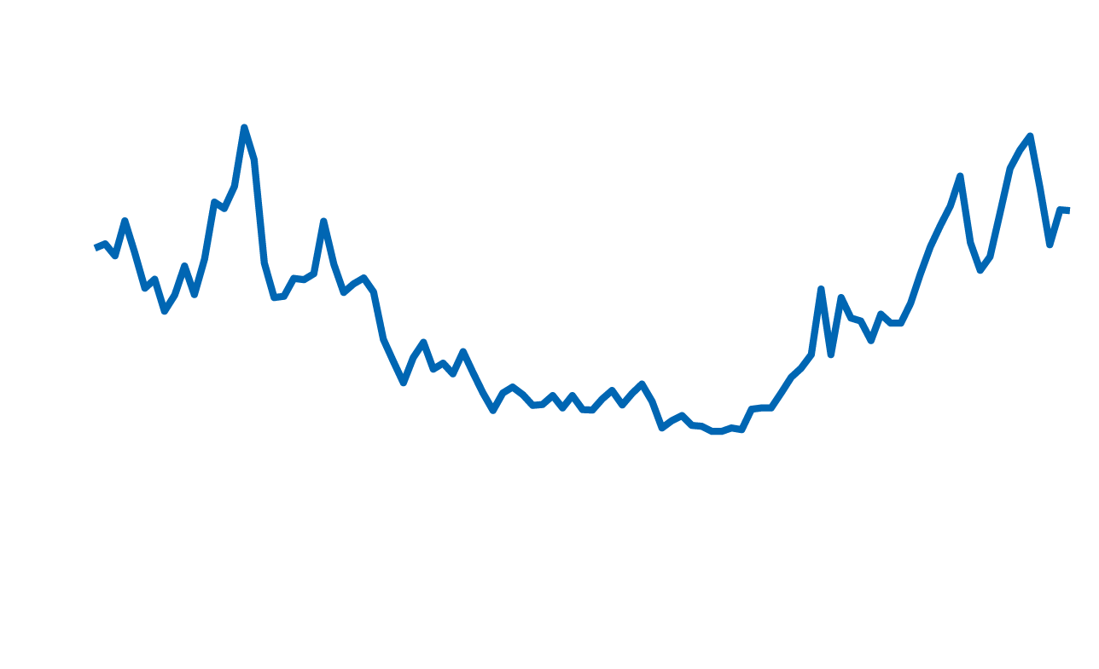



What explains the 1 percent?
In the past few years, concerns about increasing inequality have often focused on the top 1% of the income distribution.
In the last decade or so, the share of income earned by this group has risen compared to the middle of last century. Why?
High income earners have bargained for higher salaries, perhaps due to decreasing marginal tax rates, or a breakdown of formal or informal “pay codes”.
Changes in technology have amplified the superstar effect.
The disproportionate political influence of high income earners may have allowed them to influence laws in their favor.

Slide 46
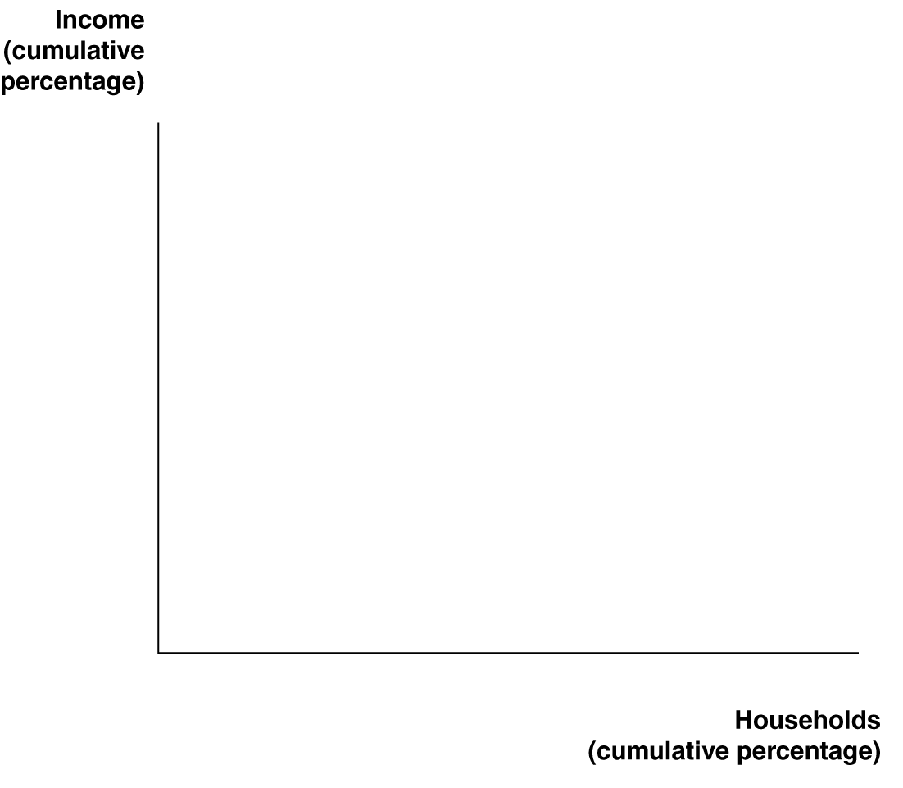

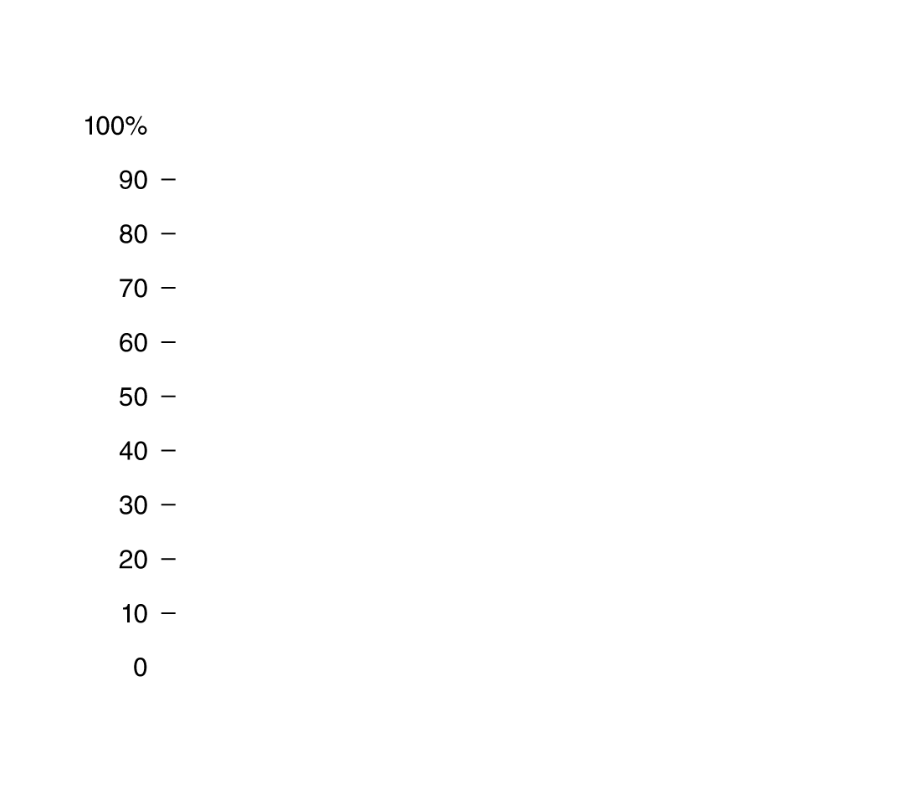

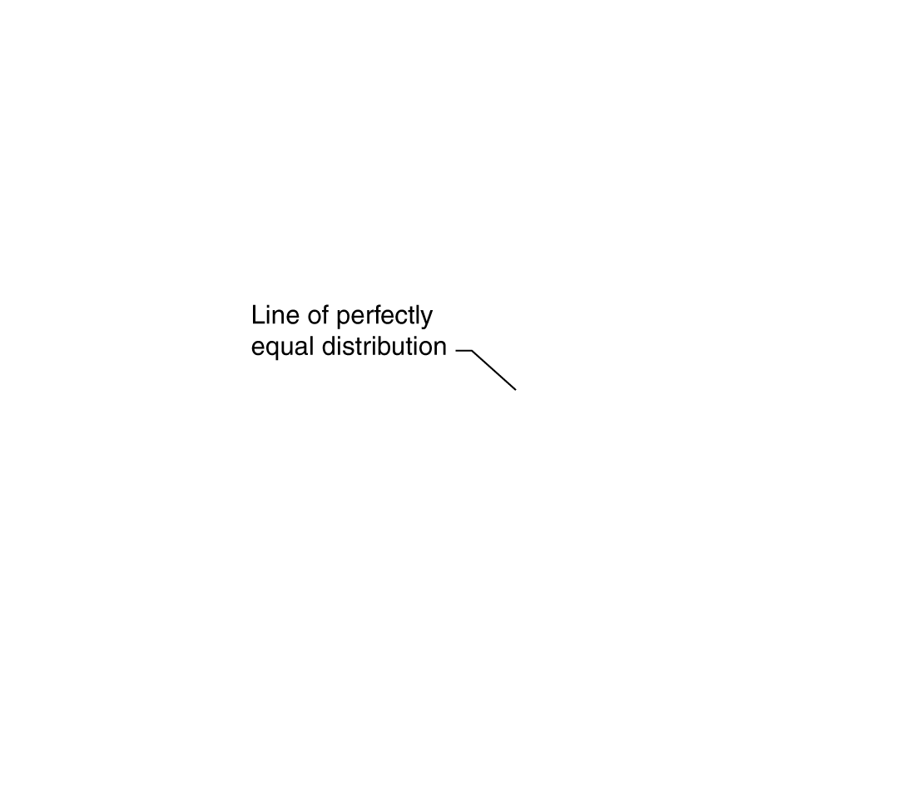



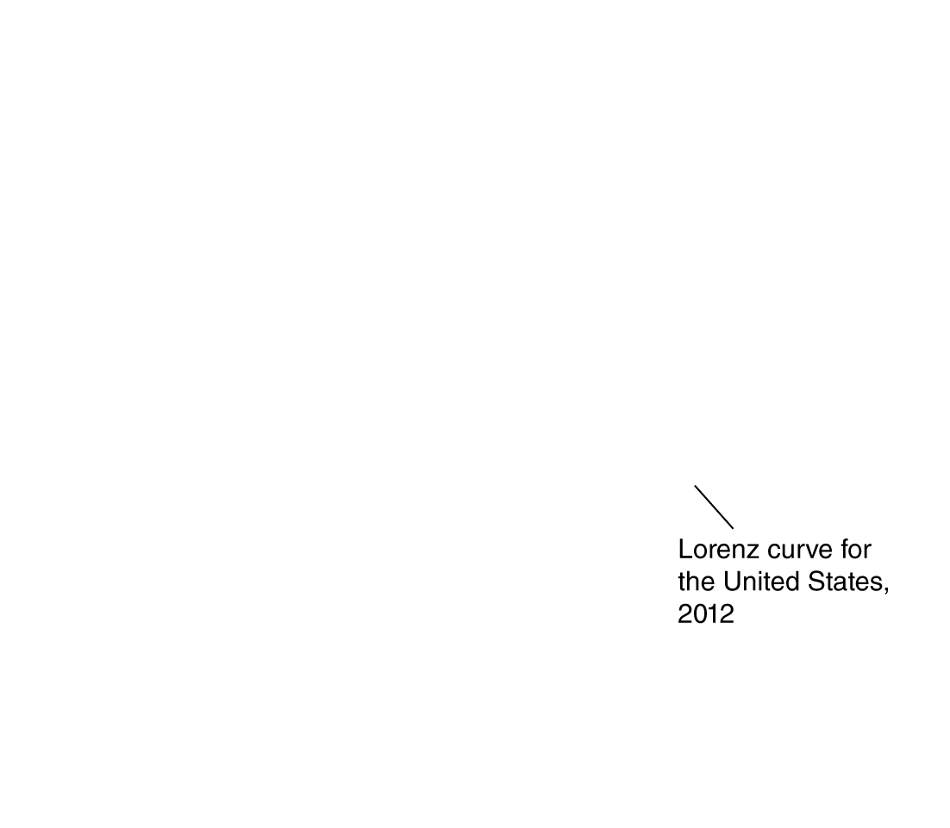

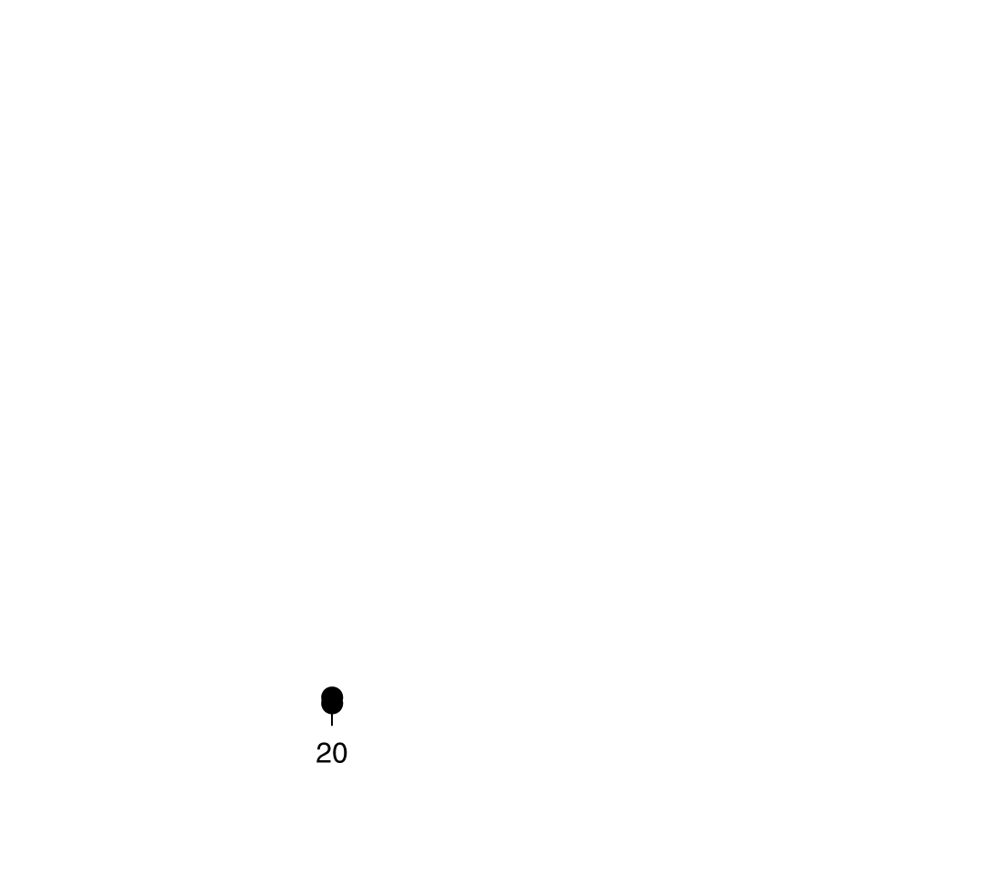


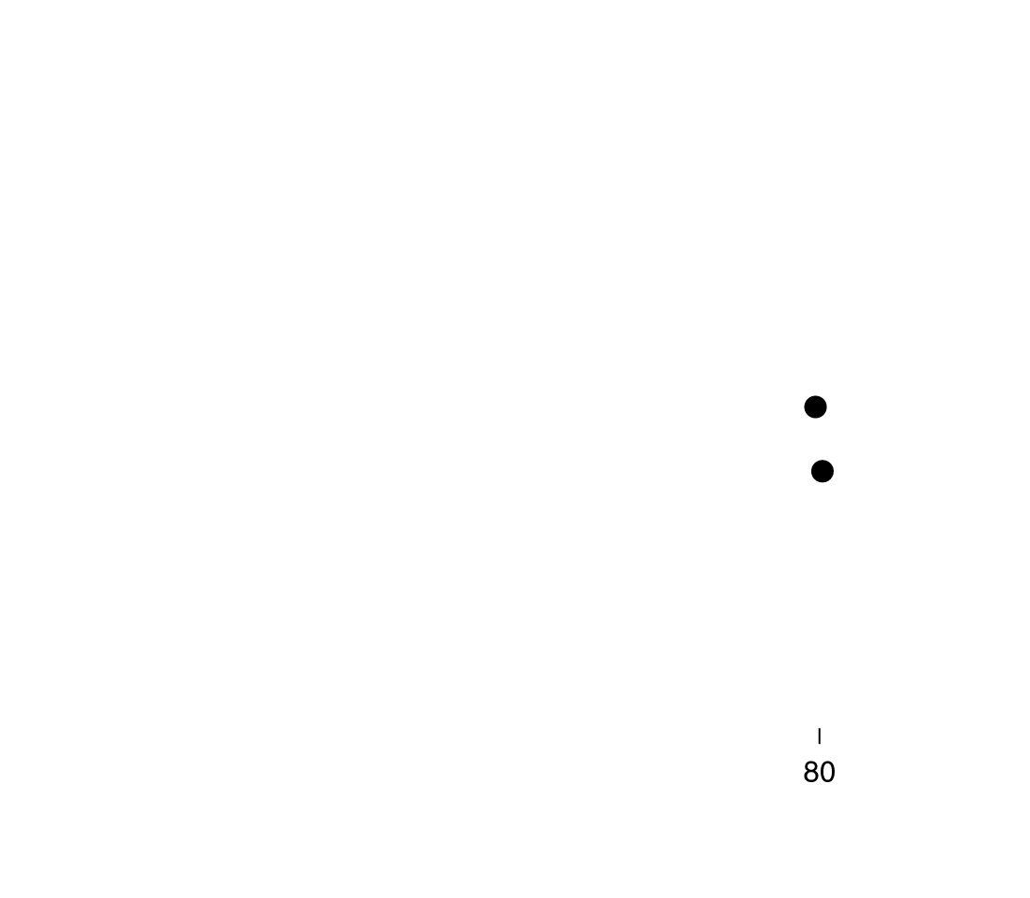

Showing the income distribution with a Lorenz curve
A Lorenz curve shows the distribution of income by arraying incomes from lowest to highest on the horizontal axis and indicating the cumulative fraction of income earned by each fraction of households on the vertical axis.
The figure shows Lorenz curves for the United States for 1980 and 2011.
If incomes were perfectly equal, the Lorenz curve would be the diagonal line.
Figure 18.7a
The Lorenz curve and Gini coefficient
Notes:
In panel (a), the Lorenz curves show the distribution of income by arraying incomes
from the lowest to the highest on the horizontal axis and indicating the
cumulative fraction of income by each fraction of households on the vertical axis.
The straight line represents perfect income equality. Because the Lorenz curve for
1980 is closer to the line of perfect equality than the Lorenz curve for 2011, we
know that income was more equally distributed in 1980 than in 2012. In panel (b),
we show the Gini coefficient, which is equal to the area between the line of perfect
income equality and the Lorenz curve—area A—divided by the whole area below
the line of perfect equality—area A plus area B. The closer the Gini coefficient is
to 1, the more unequal the income distribution.

Slide 47













Measuring income inequality with the Gini coefficient
The larger the area between the actual Lorenz curve and the perfect equality Lorenz curve, the more unequal are incomes.
We measure this inequality with the Gini coefficient:
Perfect equality in incomes would give a Gini coefficient of 0; if all income was earned by one person, the Gini coefficient would be 1.
The U.S. Gini coefficient for incomes rose from 0.403 in 1980 to 0.477 in 2012.
A B
Figure 18.7b
The Lorenz curve and Gini coefficient

Slide 48

Income mobility in the United States
Income inequality is more concerning if people are permanently poor and/or rich.
The figure shows a substantial amount of income mobility, even in a short period of time.
Example: Only 69.1% of households who were in the lowest 20% of income in 2004 continued to be in the lowest 20% in 2007.
Figure 18.8
Income mobility in the United States, 2004-2007

Slide 49
The effect of government actions on inequality
Inequality is also less concerning if the actions of the government reduce the inequality.
For example, federal income taxes are progressive, automatically reducing income inequality.
Further, there are transfer payments to individuals from the government, like Social Security and unemployment benefits.
The figures we have seen are before taxes and transfer payments. Income inequality after these is substantially smaller.
Also, many poor people receive noncash benefits, like Supplemental Nutrition Assistance Program (“food stamp”) benefits, and housing benefits. This further reduces inequality.
There is substantial debate over how much action the government ought to take in this regard.

Slide 50
Income distribution around the world
A common measure of inequality is the ratio of the income received by the highest 20% of earners to that of the lowest 20% of earners.
The table shows this ratio for a selection of countries.
America has the highest ratio of any rich nation.
Country | Ratio of Income Received by Highest 20% to Income Received by Lowest 20%
Bolivia | 27.8
Brazil | 20.6
Paraguay | 17.3
United States | 15.9
Chile | 13.5
Argentina | 11.3
Canada | 11.2
China | 10.1
United Kingdom | 5.3
Italy | 5.6
France | 4.6
Germany | 4.5
Sweden | 3.6
Japan | 3.0
Table 18.8
Income inequality around the world

Slide 51
Poverty around the world
World standards for poverty are substantially lower than in the United States.
A common threshold used by development economists is $1 per person per day.
By this standard, world poverty has declined significantly over the last few decades.
Regional differences in these declines can be attributed to differences in economic growth rates.
 | Percentage of the Population in Poverty
Region | 1970 | 2006
World | 26.8% | 5.4%
East Asia | 58.8 | 1.7
South Asia | 20.1 | 2.6
Middle East and North Africa | 8.4 | 5.2
Latin America | 11.6 | 3.1
Sub-Saharan Africa | 39.9 | 31.8
Table 18.9
Poverty has declined dramatically around the world since 1970

Slide 52
Common misconceptions to avoid
The legal obligation to pay a tax is not the same as who actually bears the burden of a tax. The latter is determined by elasticities of demand and supply.
Figures given for inequality are generally before taxes and transfers; inequality after these is substantially lower.

